Slide 1
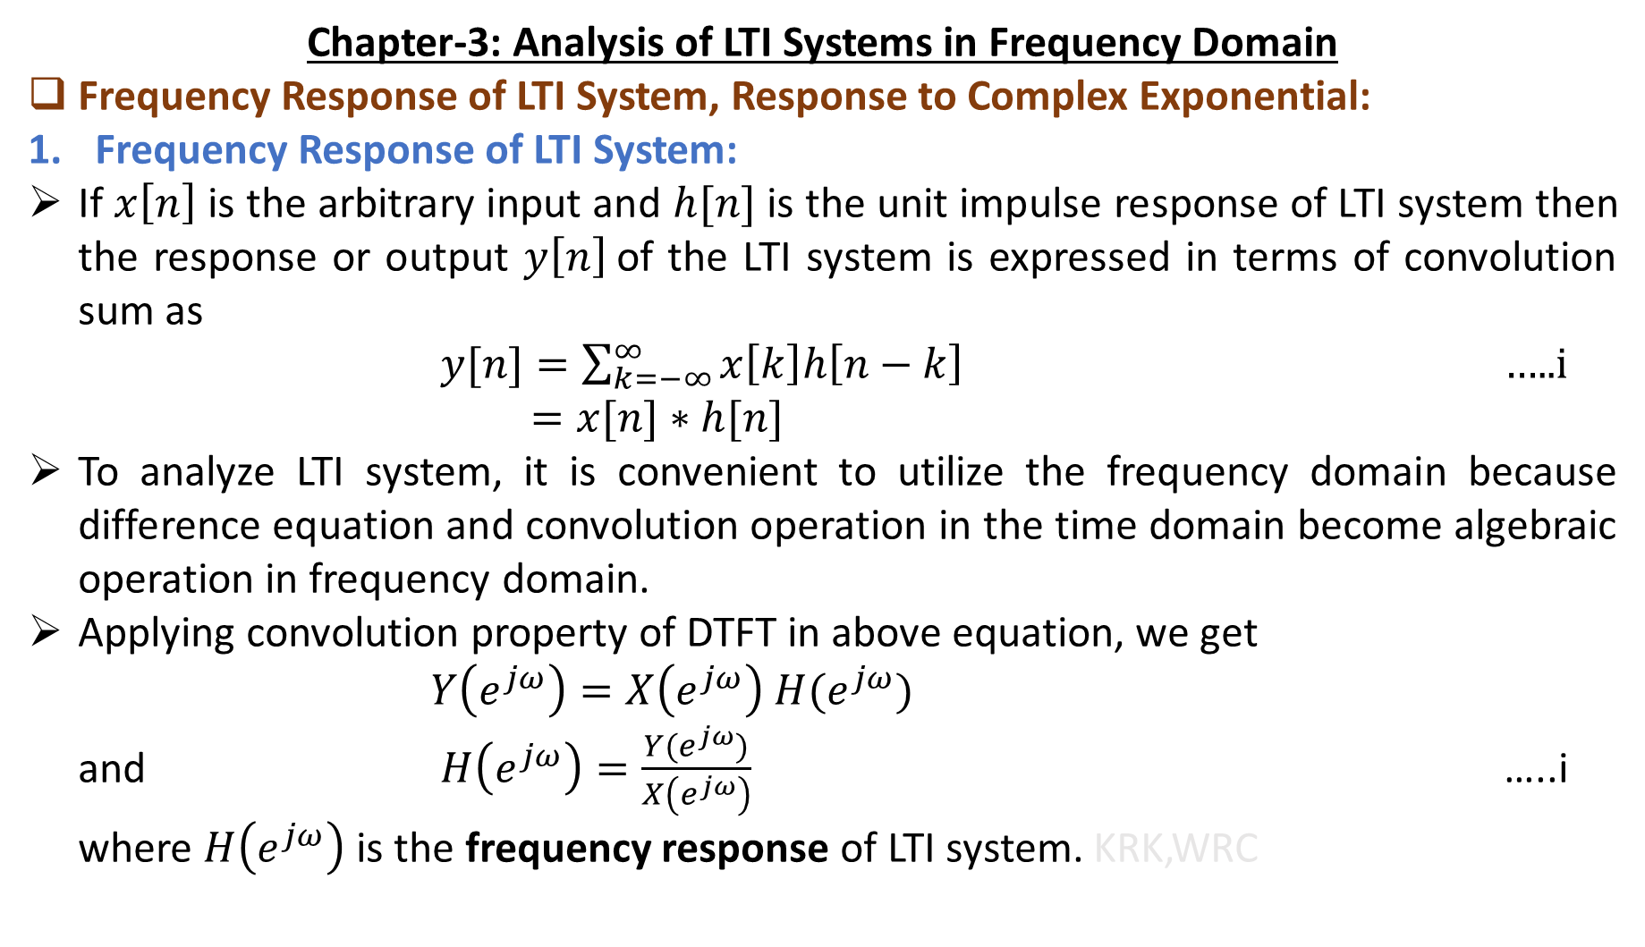
Chapter-3: Analysis of LTI Systems in Frequency Domain
Frequency Response of LTI System, Response to Complex Exponential:
Frequency Response of LTI System:
If $x\left[n\right]$ is the arbitrary input and $h[n]$ is the unit impulse response of LTI system then the response or output $y\left[n\right]$of the LTI system is expressed in terms of convolution sum as
$y[n]=\sum_{k=−∞}^{∞}{x\left[k\right]h\left[n−k\right]}$ …..i
$=x[n]∗h[n]$
To analyze LTI system, it is convenient to utilize the frequency domain because difference equation and convolution operation in the time domain become algebraic operation in frequency domain.
Applying convolution property of DTFT in above equation, we get
$Y\left(e^{jω}\right)=X\left(e^{jω}\right) H(e^{jω})$
and $H\left(e^{jω}\right)=\frac{Y(e^{jω})}{X\left(e^{jω}\right)}$ …..i
where $H\left(e^{jω}\right)$ is the frequency response of LTI system. KRK,WRC

Slide 2
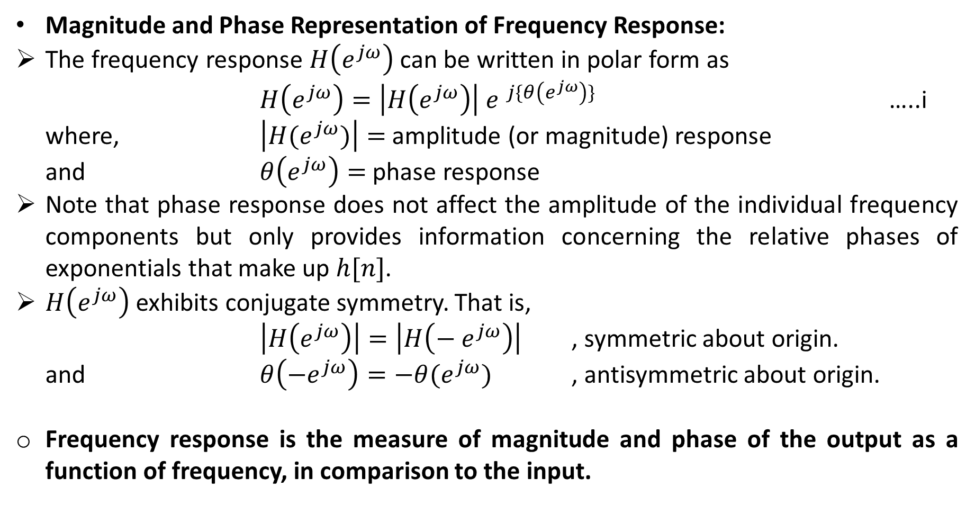
Magnitude and Phase Representation of Frequency Response:
The frequency response $H\left(e^{jω}\right)$ can be written in polar form as
$H\left(e^{jω}\right)=\left|H\left(e^{jω}\right)\right|{ e }^{j\{θ\left(e^{jω}\right)\}}$ …..i
where, $\left|H{(e}^{jω})\right|=$amplitude (or magnitude) response
and $θ\left(e^{jω}\right)=$ phase response
Note that phase response does not affect the amplitude of the individual frequency components but only provides information concerning the relative phases of exponentials that make up $h[n]$.
$H\left(e^{jω}\right)$ exhibits conjugate symmetry. That is,
$\left|H\left(e^{jω}\right)\right|=\left|H\left(−{ e}^{jω}\right)\right|$ , symmetric about origin.
and $θ\left(−e^{jω}\right)=−θ(e^{jω})$ , antisymmetric about origin.
Frequency response is the measure of magnitude and phase of the output as a function of frequency, in comparison to the input.

Slide 3
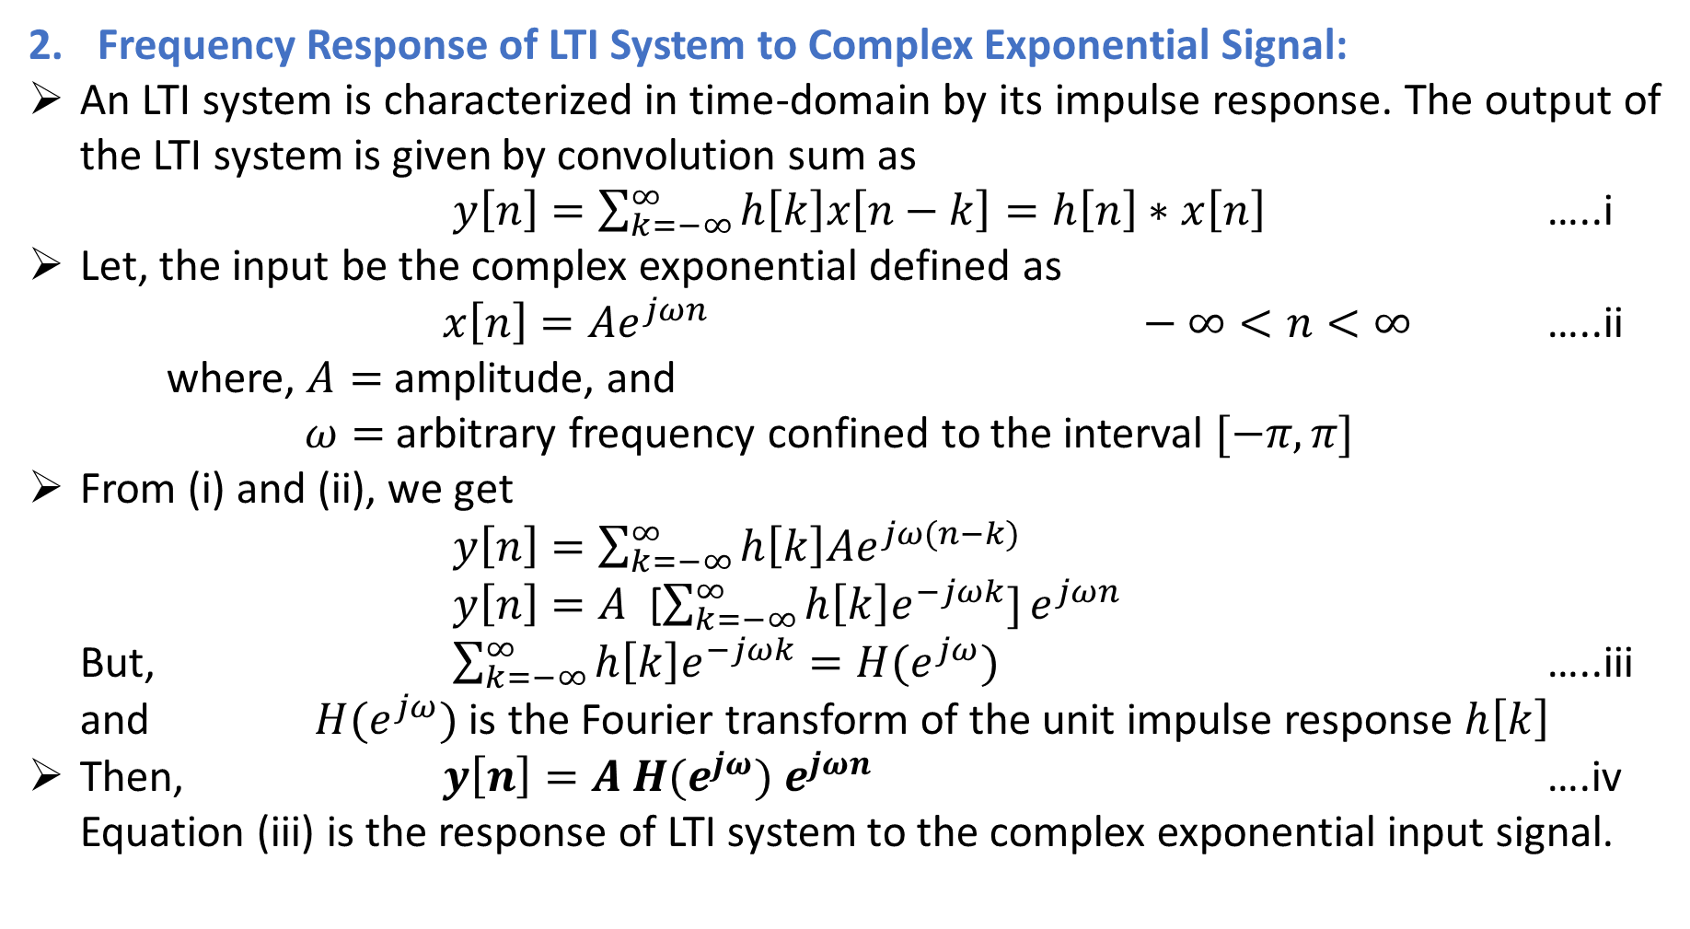
Frequency Response of LTI System to Complex Exponential Signal:
An LTI system is characterized in time-domain by its impulse response. The output of the LTI system is given by convolution sum as
$y\left[n\right]=\sum_{k=−∞}^{∞}{h\left[k\right]x\left[n−k\right]}=h\left[n\right]∗x\left[n\right]$ …..i
Let, the input be the complex exponential defined as
$x\left[n\right]=Ae^{jωn} −∞<n<∞$ …..ii
where, $A=$ amplitude, and
$ω=$ arbitrary frequency confined to the interval $[−π, π]$
From (i) and (ii), we get
$y\left[n\right]=\sum_{k=−∞}^{∞}{h\left[k\right]Ae^{jω(n−k)}}$
$y\left[n\right]=A$ [$\sum_{k=−∞}^{∞}{h\left[k\right]e^{−jωk}]}e^{jωn}$
But, $\sum_{k=−∞}^{∞}{h\left[k\right]e^{−jωk}=H(e^{jω})}$ …..iii
and $H(e^{jω})$ is the Fourier transform of the unit impulse response $h\left[k\right]$
Then, $y\left[n\right]=A$ $H(e^{jω}) e^{jωn}$ ….iv
Equation (iii) is the response of LTI system to the complex exponential input signal.

Slide 4
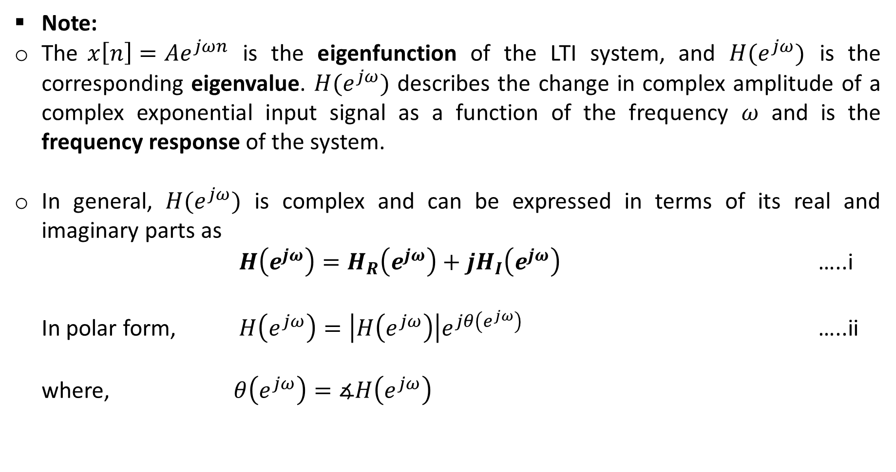
Note:
The $x\left[n\right]=Ae^{jωn}$ is the eigenfunction of the LTI system, and $H(e^{jω})$ is the corresponding eigenvalue. $H(e^{jω})$ describes the change in complex amplitude of a complex exponential input signal as a function of the frequency $ω$ and is the frequency response of the system.
In general, $H(e^{jω})$ is complex and can be expressed in terms of its real and imaginary parts as
$H\left(e^{jω}\right)=H_{R}\left(e^{jω}\right)+jH_{I}\left(e^{jω}\right)$ …..i
In polar form, $H\left(e^{jω}\right)=\left|H\left(e^{jω}\right)\right|e^{jθ\left(e^{jω}\right)}$ …..ii
where, $θ\left(e^{jω}\right)=∡H\left(e^{jω}\right)$

Slide 5
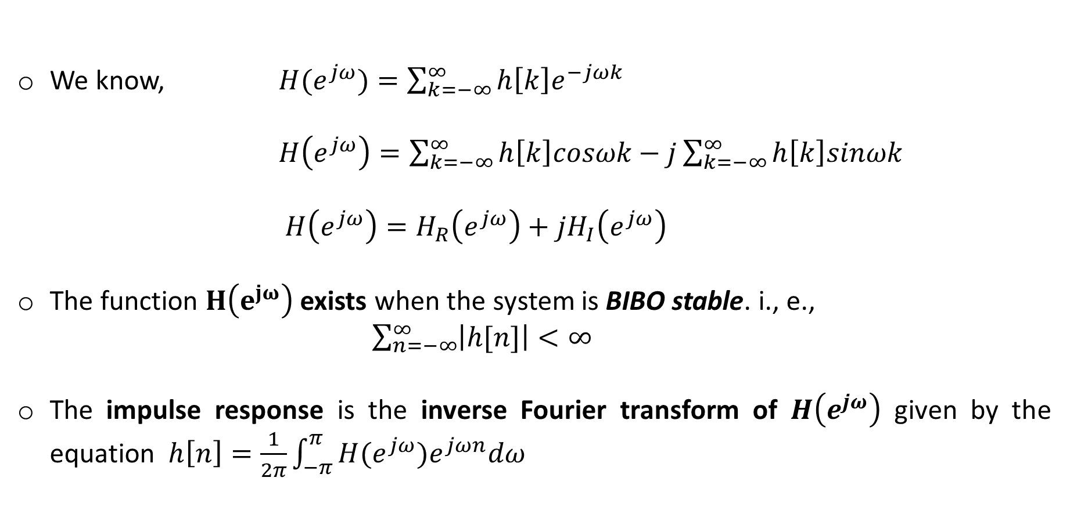
We know, $H(e^{jω})=\sum_{k=−∞}^{∞}{h\left[k\right]e^{−jωk}}$
$H\left(e^{jω}\right)=\sum_{k=−∞}^{∞}{h\left[k\right]cosωk}−j\sum_{k=−∞}^{∞}{h\left[k\right]sinωk}$
$H\left(e^{jω}\right)=H_{R}\left(e^{jω}\right)+jH_{I}\left(e^{jω}\right)$
The function $H\left(e^{jω}\right)$ exists when the system is BIBO stable. i., e.,
$\sum_{n=−∞}^{∞}{\left|h[n]\right|}<∞$
The impulse response is the inverse Fourier transform of $H\left(e^{jω}\right)$ given by the equation $h\left[n\right]=\frac{1}{2π}\int_{−π}^{π}{H(e^{jω})e^{jωn}dω}$

Slide 6
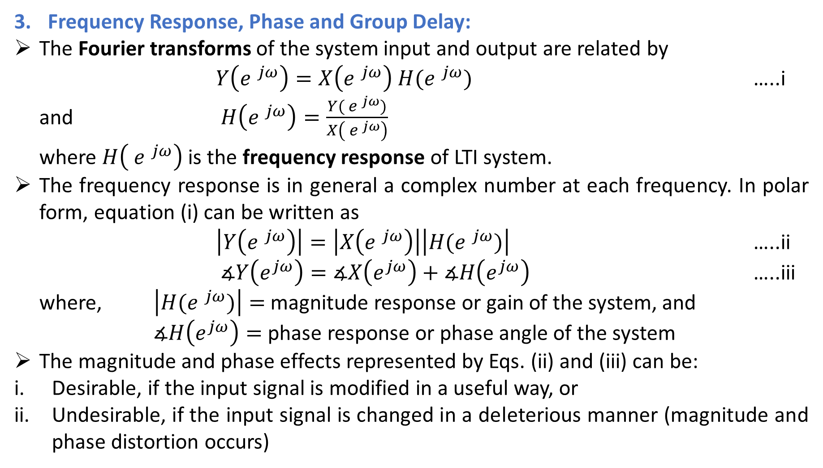
Frequency Response, Phase and Group Delay:
The Fourier transforms of the system input and output are related by
$Y\left({e }^{jω} \right)=X\left({e }^{jω}\right) H({e }^{jω})$ …..i
and $H\left({e }^{jω}\right)=\frac{Y({ e }^{jω})}{X\left({ e }^{jω}\right)}$
where $H\left({ e }^{jω}\right)$ is the frequency response of LTI system.
The frequency response is in general a complex number at each frequency. In polar form, equation (i) can be written as
$\left|Y\left({e }^{jω} \right)\right|=\left|X\left({e }^{jω}\right)\right|\left|H({e }^{jω})\right|$ …..ii
$∡Y\left(e^{jω}\right)=∡X\left(e^{jω}\right)+∡H\left(e^{jω}\right)$ …..iii
where, $\left|H({e }^{jω})\right|=$ magnitude response or gain of the system, and
$∡H\left(e^{jω}\right)=$ phase response or phase angle of the system
The magnitude and phase effects represented by Eqs. (ii) and (iii) can be:
Desirable, if the input signal is modified in a useful way, or
Undesirable, if the input signal is changed in a deleterious manner (magnitude and phase distortion occurs)

Slide 7
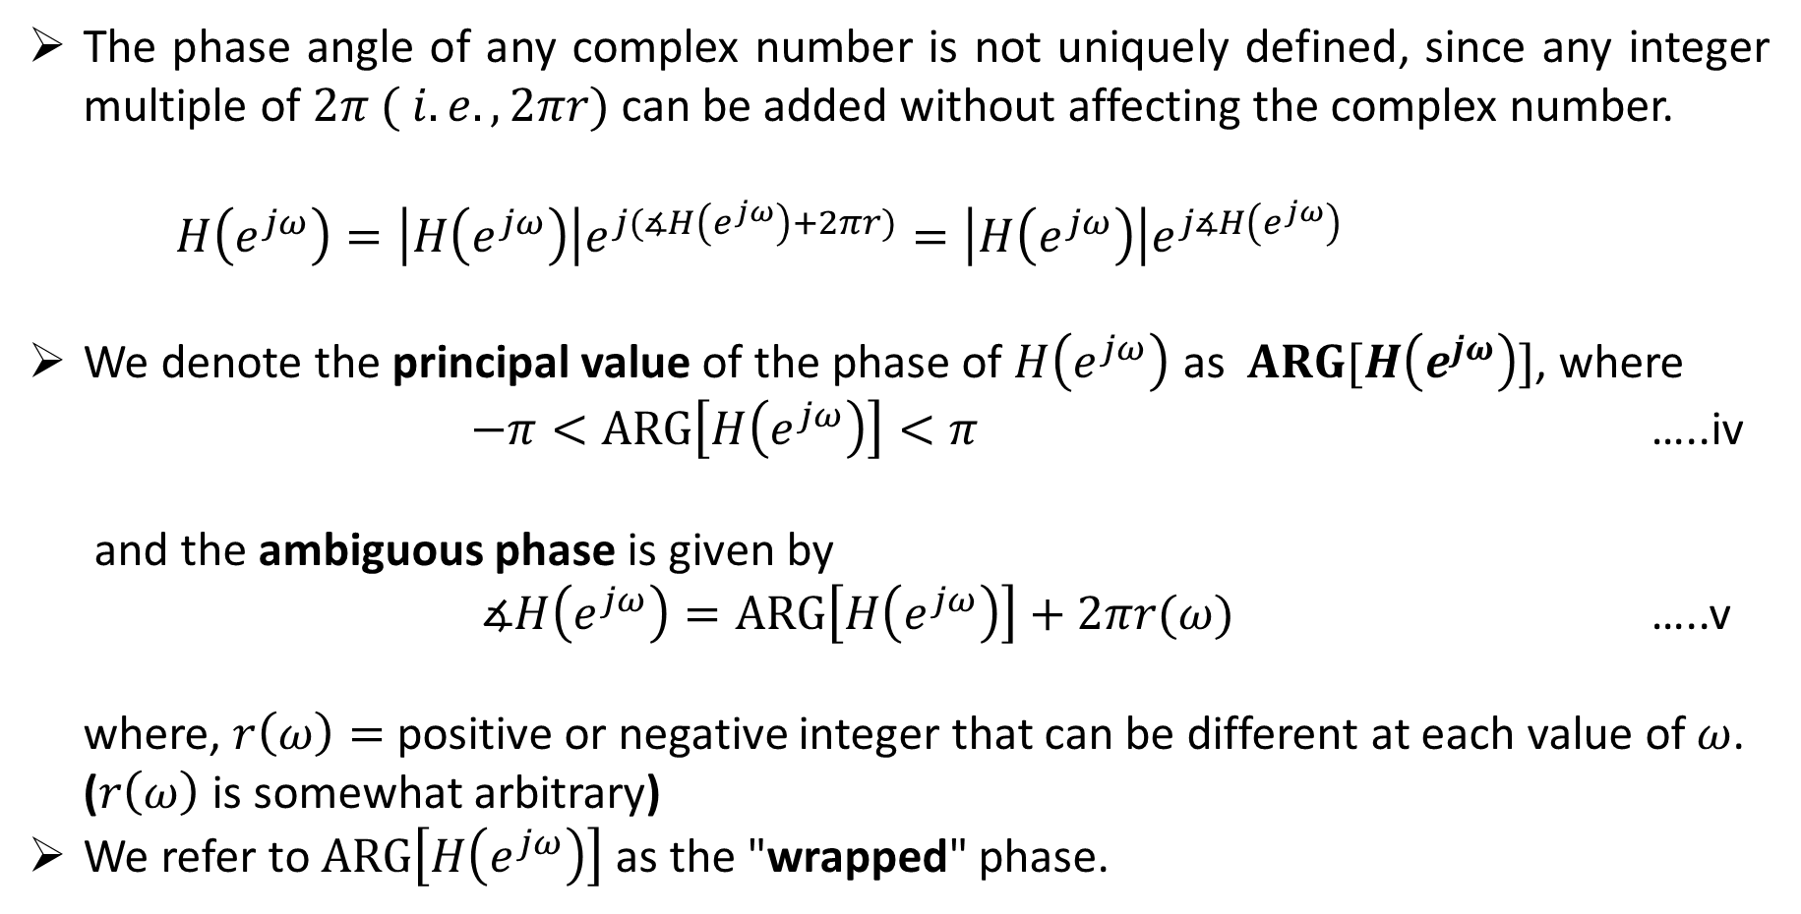
The phase angle of any complex number is not uniquely defined, since any integer multiple of $2π ( i.e.,2πr)$ can be added without affecting the complex number.
$H\left(e^{jω}\right)=\left|H\left(e^{jω}\right)\right|e^{j(∡H\left(e^{jω}\right)+2πr)}=\left|H\left(e^{jω}\right)\right|e^{j∡H\left(e^{jω}\right)}$
We denote the principal value of the phase of $H\left(e^{jω}\right)$ as $ARG[H\left(e^{jω}\right)]$, where
$−π<ARG\left[H\left(e^{jω}\right)\right]<π$ …..iv
and the ambiguous phase is given by
$∡H\left(e^{jω}\right)=ARG\left[H\left(e^{jω}\right)\right]+2πr(ω)$ …..v
where, $r\left(ω\right)=$ positive or negative integer that can be different at each value of $ω$.
($r\left(ω\right)$ is somewhat arbitrary)
We refer to $ARG\left[H\left(e^{jω}\right)\right]$ as the "wrapped" phase.

Slide 8
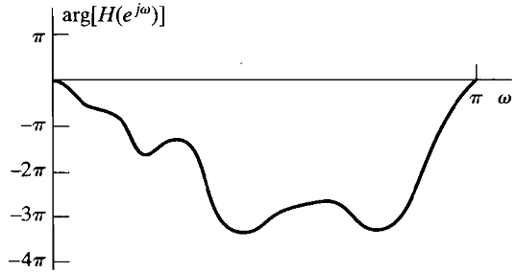
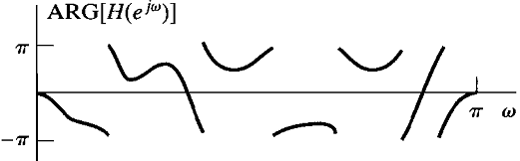
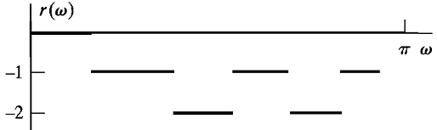
continuous (unwrapped) phase curve is denoted
as arg [H (e ^{jw})]
Principal Value
we refer to ARG [H(e^{jw})] as the "wrapped" phase,

Slide 9
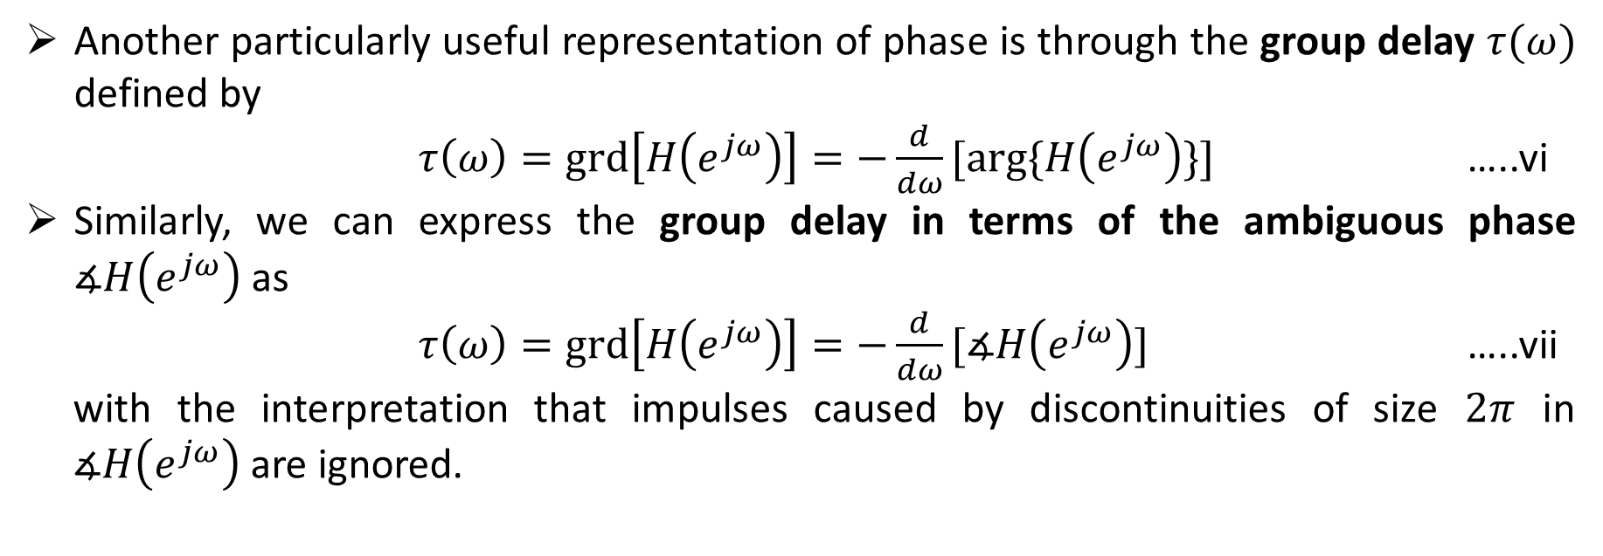
Another particularly useful representation of phase is through the group delay $τ(ω)$ defined by
$τ\left(ω\right)=grd\left[H\left(e^{jω}\right)\right]=−\frac{d}{dω}[arg⁡\{H\left(e^{jω}\right)\}]$ …..vi
Similarly, we can express the group delay in terms of the ambiguous phase $∡H\left(e^{jω}\right)$ as
$τ\left(ω\right)=grd\left[H\left(e^{jω}\right)\right]=−\frac{d}{dω}[∡H\left(e^{jω}\right)]$ …..vii
with the interpretation that impulses caused by discontinuities of size $2π$ in $∡H\left(e^{jω}\right)$ are ignored.

Slide 10
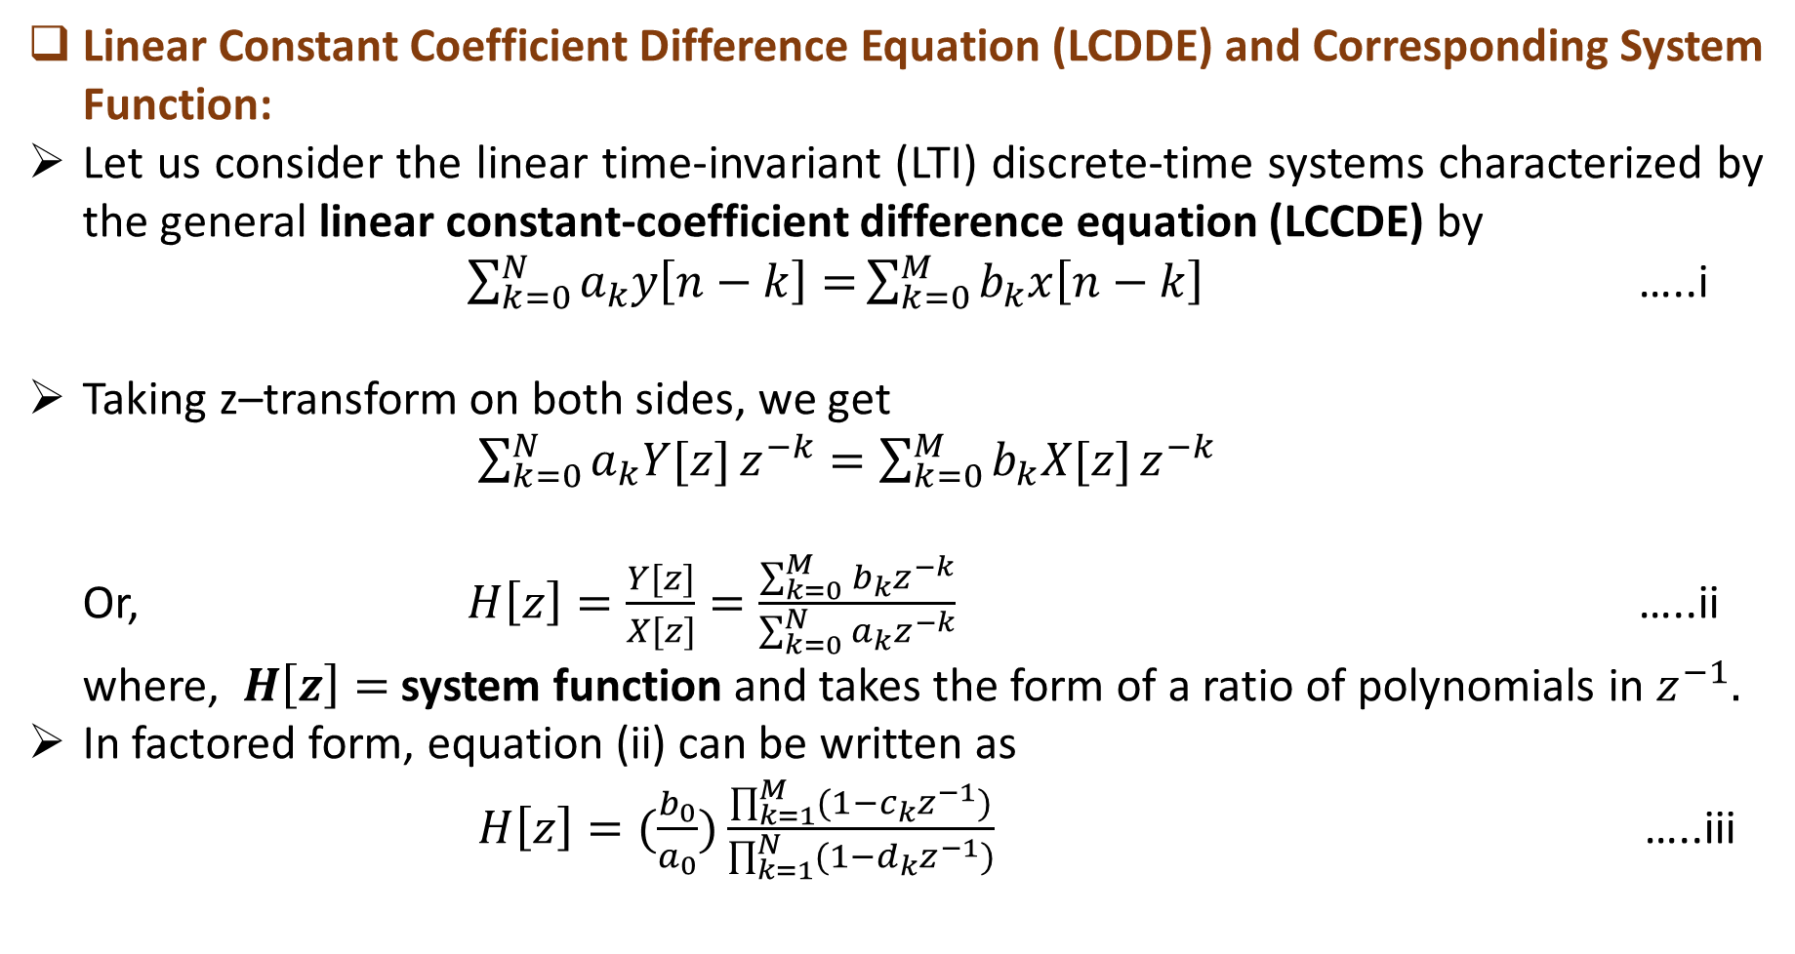
Linear Constant Coefficient Difference Equation (LCDDE) and Corresponding System Function:
Let us consider the linear time-invariant (LTI) discrete-time systems characterized by the general linear constant-coefficient difference equation (LCCDE) by
$\sum_{k=0}^{N}{a_{k}y\left[n−k\right]=}\sum_{k=0}^{M}{b_{k}x\left[n−k\right]}$ …..i
Taking z–transform on both sides, we get
$\sum_{k=0}^{N}{a_{k}Y[z]}z^{−k}=\sum_{k=0}^{M}{b_{k}X[z]}z^{−k}$
Or, $H\left[z\right]=\frac{Y[z]}{X[z]}=\frac{\sum_{k=0}^{M}{b_{k}}z^{−k}}{\sum_{k=0}^{N}{a_{k}}z^{−k}}$ …..ii
where, $H\left[z\right]=$system function and takes the form of a ratio of polynomials in $z^{−1}.$
In factored form, equation (ii) can be written as
$H\left[z\right]=(\frac{b_{0}}{a_{0}})\frac{\prod_{k=1}^{M}{(1−c_{k}z^{−1})}}{\prod_{k=1}^{N}{(1−d_{k}z^{−1})}}$ …..iii

Slide 11
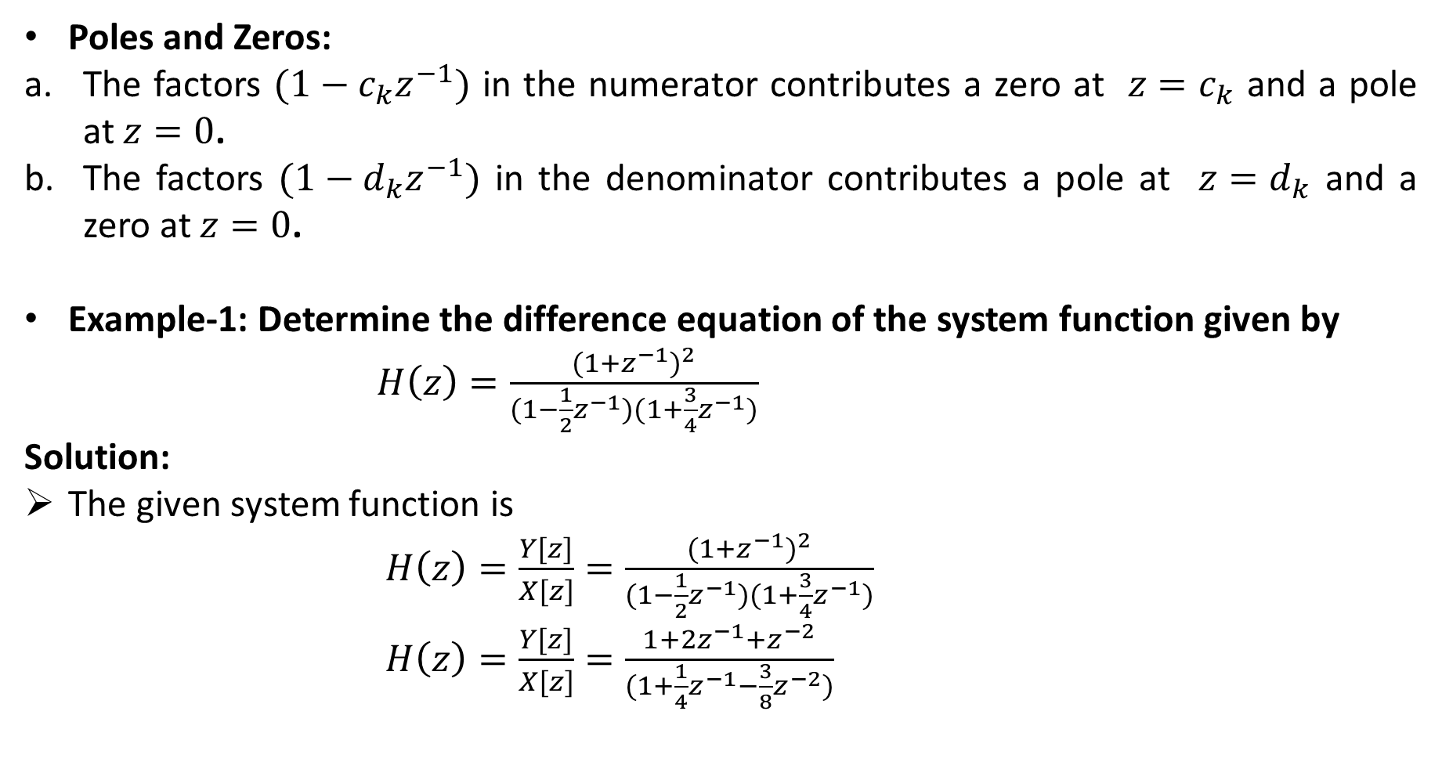
Poles and Zeros:
The factors $(1−c_{k}z^{−1})$ in the numerator contributes a zero at $z{=c}_{k}$ and a pole at $z=0$.
The factors $(1−d_{k}z^{−1})$ in the denominator contributes a pole at $z{=d}_{k}$ and a zero at $z=0$.
Example-1: Determine the difference equation of the system function given by
$H\left(z\right)=\frac{{(1+z^{−1})}^{2}}{(1−\frac{1}{2}z^{−1})(1+\frac{3}{4}z^{−1})}$
Solution:
The given system function is
$H\left(z\right)=\frac{Y[z]}{X[z]}=\frac{{(1+z^{−1})}^{2}}{(1−\frac{1}{2}z^{−1})(1+\frac{3}{4}z^{−1})}$
$H\left(z\right)=\frac{Y[z]}{X[z]}=\frac{1+{2z}^{−1}+z^{−2}}{(1+\frac{1}{4}z^{−1}−\frac{3}{8}z^{−2})}$

Slide 12

Or, $Y\left[z\right]=$

Slide 13
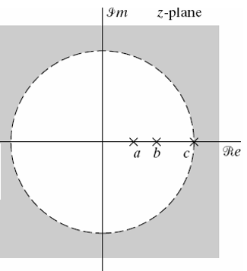
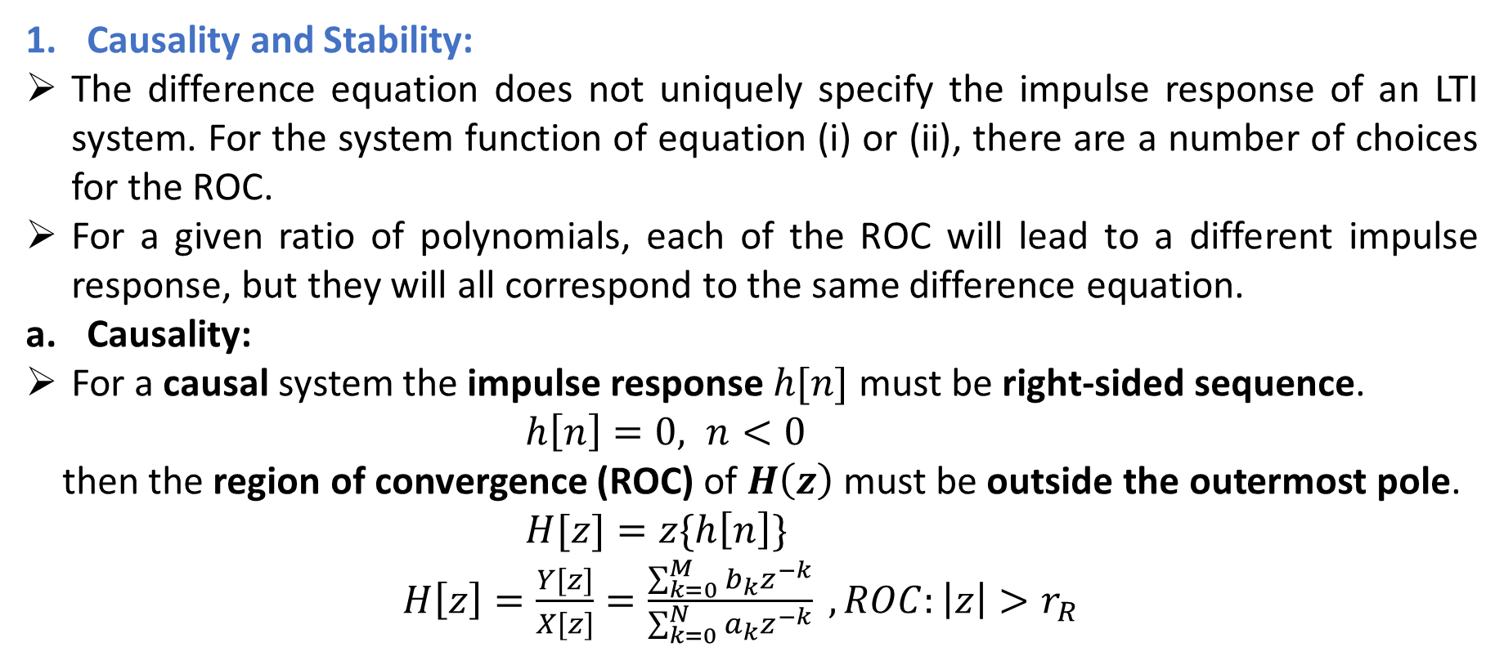
Causality and Stability:
The difference equation does not uniquely specify the impulse response of an LTI system. For the system function of equation (i) or (ii), there are a number of choices for the ROC.
For a given ratio of polynomials, each of the ROC will lead to a different impulse response, but they will all correspond to the same difference equation.
Causality:
For a causal system the impulse response $h[n]$ must be right-sided sequence.
$h\left[n\right]=0, n<0$
then the region of convergence (ROC) of $H\left(z\right)$ must be outside the outermost pole.
$H[z]=z\{h\left[n\right]\}$
$H\left[z\right]=\frac{Y[z]}{X[z]}=\frac{\sum_{k=0}^{M}{b_{k}}z^{−k}}{\sum_{k=0}^{N}{a_{k}}z^{−k}} , ROC:\left|z\right|>r_{R}$

Slide 14
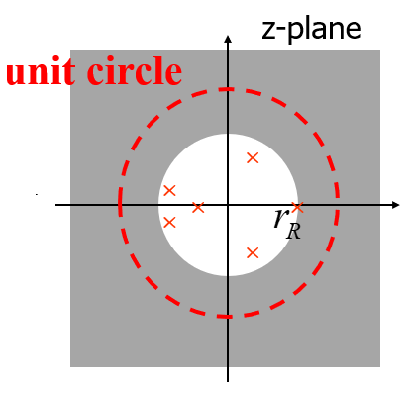
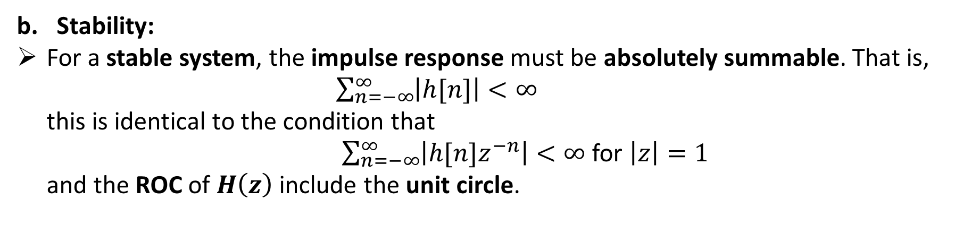
Stability:
For a stable system, the impulse response must be absolutely summable. That is,
$\sum_{n=−∞}^{∞}{\left|h[n]\right|<∞}$
this is identical to the condition that
$\sum_{n=−∞}^{∞}{\left|h[n]z^{−n}\right|<∞}$ for $\left|z\right|=1$
and the ROC of $H\left(z\right)$include the unit circle.

Slide 15
Causality and Stability Conditions:
Causal: ROC must be outside the outermost pole.
Stable: ROC includes the unit circle.
Causal and stable: All the poles of the system function are inside the unit circle;
ROC is outside the outermost pole, and includes the unit circle.
Example:

Slide 16
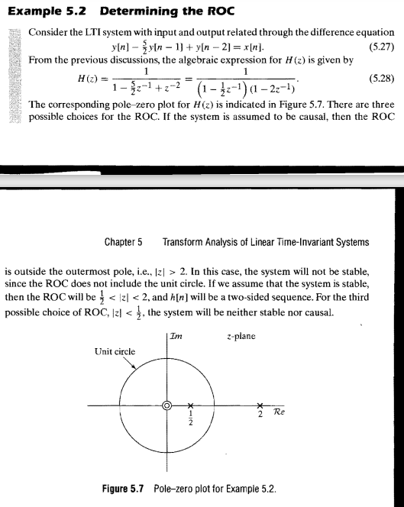

Slide 17
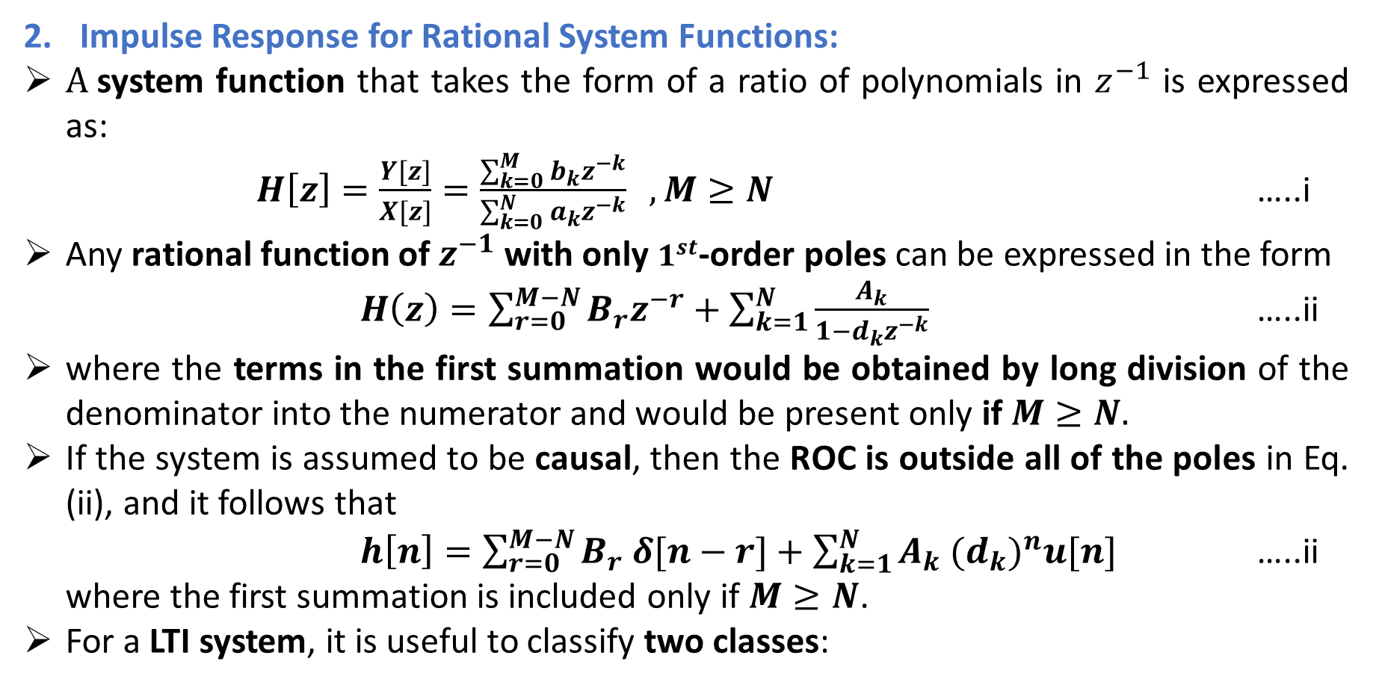
Impulse Response for Rational System Functions:
$A$system function that takes the form of a ratio of polynomials in $z^{−1}$ is expressed as:
$H\left[z\right]=\frac{Y[z]}{X[z]}=\frac{\sum_{k=0}^{M}{b_{k}}z^{−k}}{\sum_{k=0}^{N}{a_{k}}z^{−k}} , M≥N$ …..i
Any rational function of $z^{−1}$ with only $1^{st}$-order poles can be expressed in the form
$H\left(z\right)=\sum_{r=0}^{M−N}{B_{r}z^{−r}+\sum_{k=1}^{N}{\frac{A_{k}}{1−d_{k}z^{−k}}}}$ …..ii
where the terms in the first summation would be obtained by long division of the denominator into the numerator and would be present only if $M≥N.$
If the system is assumed to be causal, then the ROC is outside all of the poles in Eq. (ii), and it follows that
$h\left[n\right]=\sum_{r=0}^{M−N}{B_{r} δ[n−r]+\sum_{k=1}^{N}{A_{k} {{(d}_{k})}^{n}u[n] }}$ …..ii
where the first summation is included only if $M≥N$.
For a LTI system, it is useful to classify two classes:

Slide 18
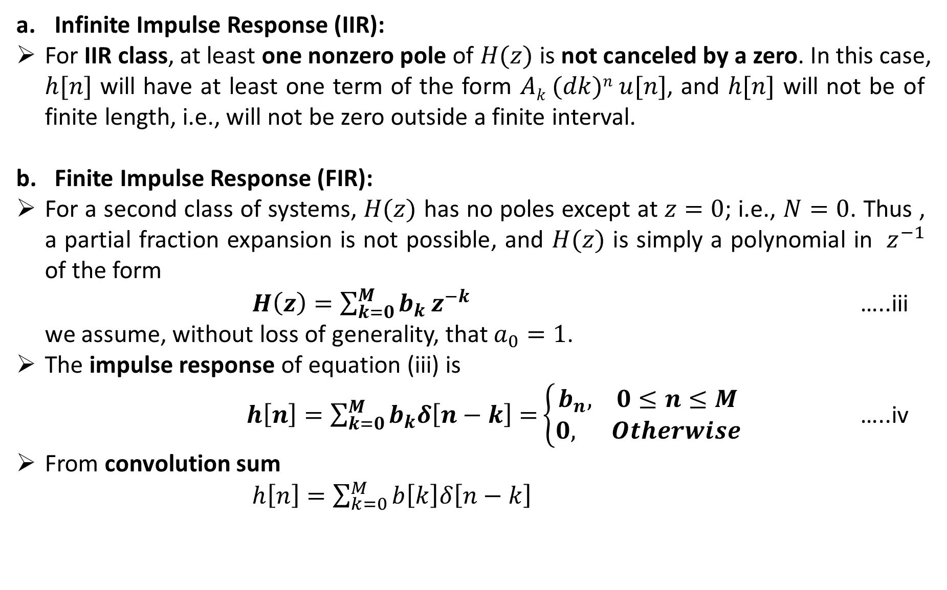
Infinite Impulse Response (IIR):
For IIR class, at least one nonzero pole of $H(z)$ is not canceled by a zero. In this case, $h[n]$ will have at least one term of the form $Ak (dk)n u[n]$, and $h[n]$ will not be of finite length, i.e., will not be zero outside a finite interval.
Finite Impulse Response (FIR):
For a second class of systems, $H(z)$ has no poles except at $z=0$; i.e., $N=0$. Thus , a partial fraction expansion is not possible, and $H(z)$ is simply a polynomial in $z^{−1}$ of the form
$H\left(z\right)=\sum_{k=0}^{M}{b_{k}}z^{−k}$ …..iii
we assume, without loss of generality, that $a_{0}=1$.
The impulse response of equation (iii) is
$h\left[n\right]=\sum_{k=0}^{M}{b_{k}δ\left[n−k\right]=}\left\{\begin{aligned}b_{n}, 0≤n≤M \\ 0, Otherwise\end{aligned}\right.$ …..iv
From convolution sum
$h\left[n\right]=\sum_{k=0}^{M}{b\left[k\right]δ\left[n−k\right]}$

Slide 19
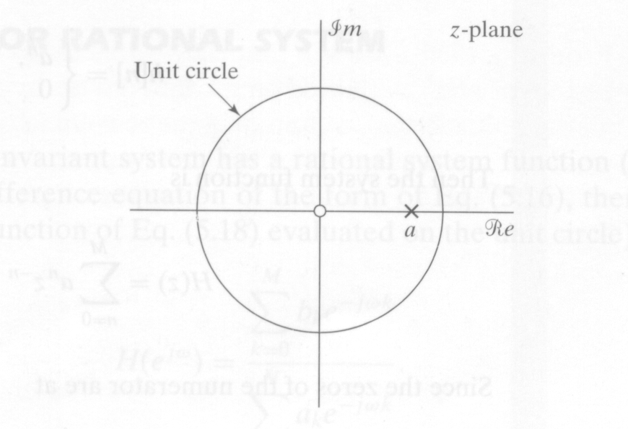
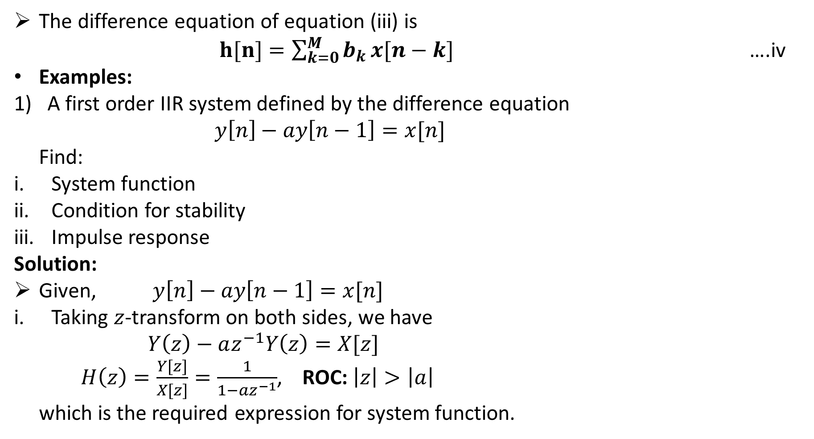
The difference equation of equation (iii) is
$h[n]=\sum_{k=0}^{M}{b_{k}}x[n−k]$ ….iv
Examples:
A first order IIR system defined by the difference equation
$y\left[n\right]−ay\left[n−1\right]=x[n]$
Find:
System function
Condition for stability
Impulse response
Solution:
Given, $y\left[n\right]−ay\left[n−1\right]=x[n]$
Taking $z$-transform on both sides, we have
$Y\left(z\right)−az^{−1}Y\left(z\right)=X[z]$
$H\left(z\right)=\frac{Y[z]}{X[z]}=\frac{1}{1−az^{−1}}$, ROC: $\left|z\right|>\left|a\right|$
which is the required expression for system function.

Slide 20
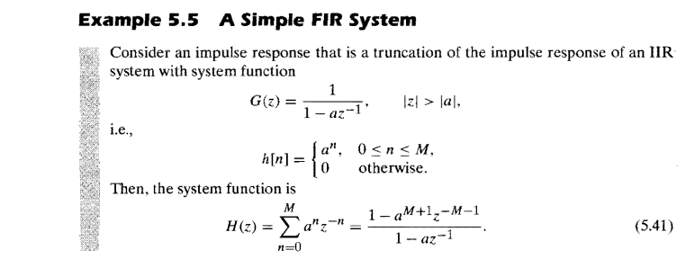
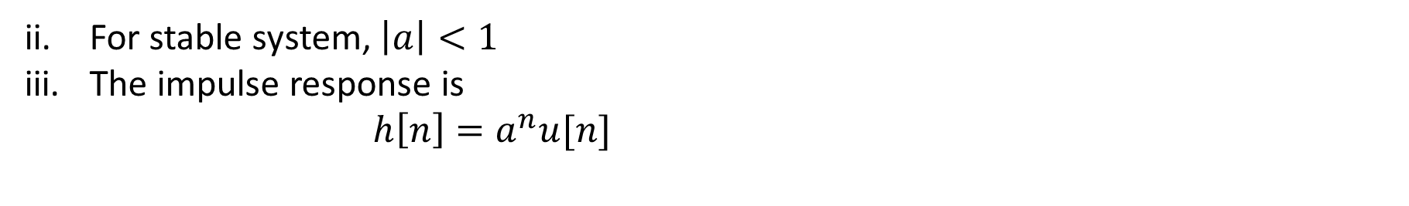
For stable system, $\left|a\right|<1$
The impulse response is
$h\left[n\right]=a^{n}u[n]$

Slide 21
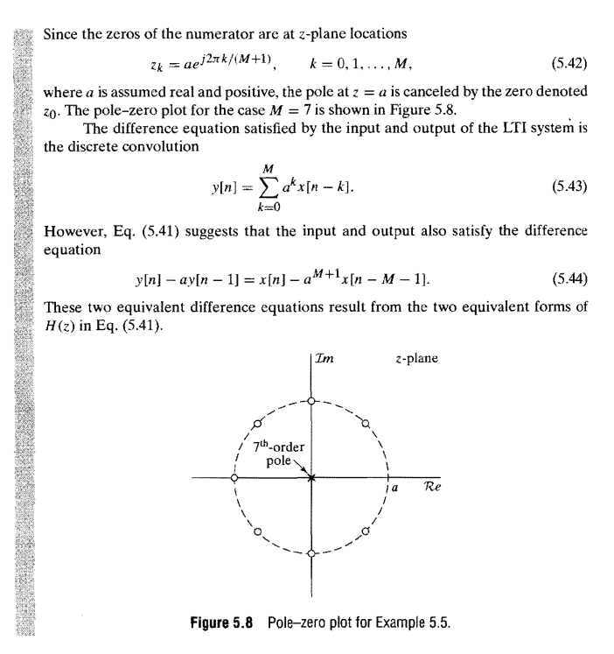

Slide 22
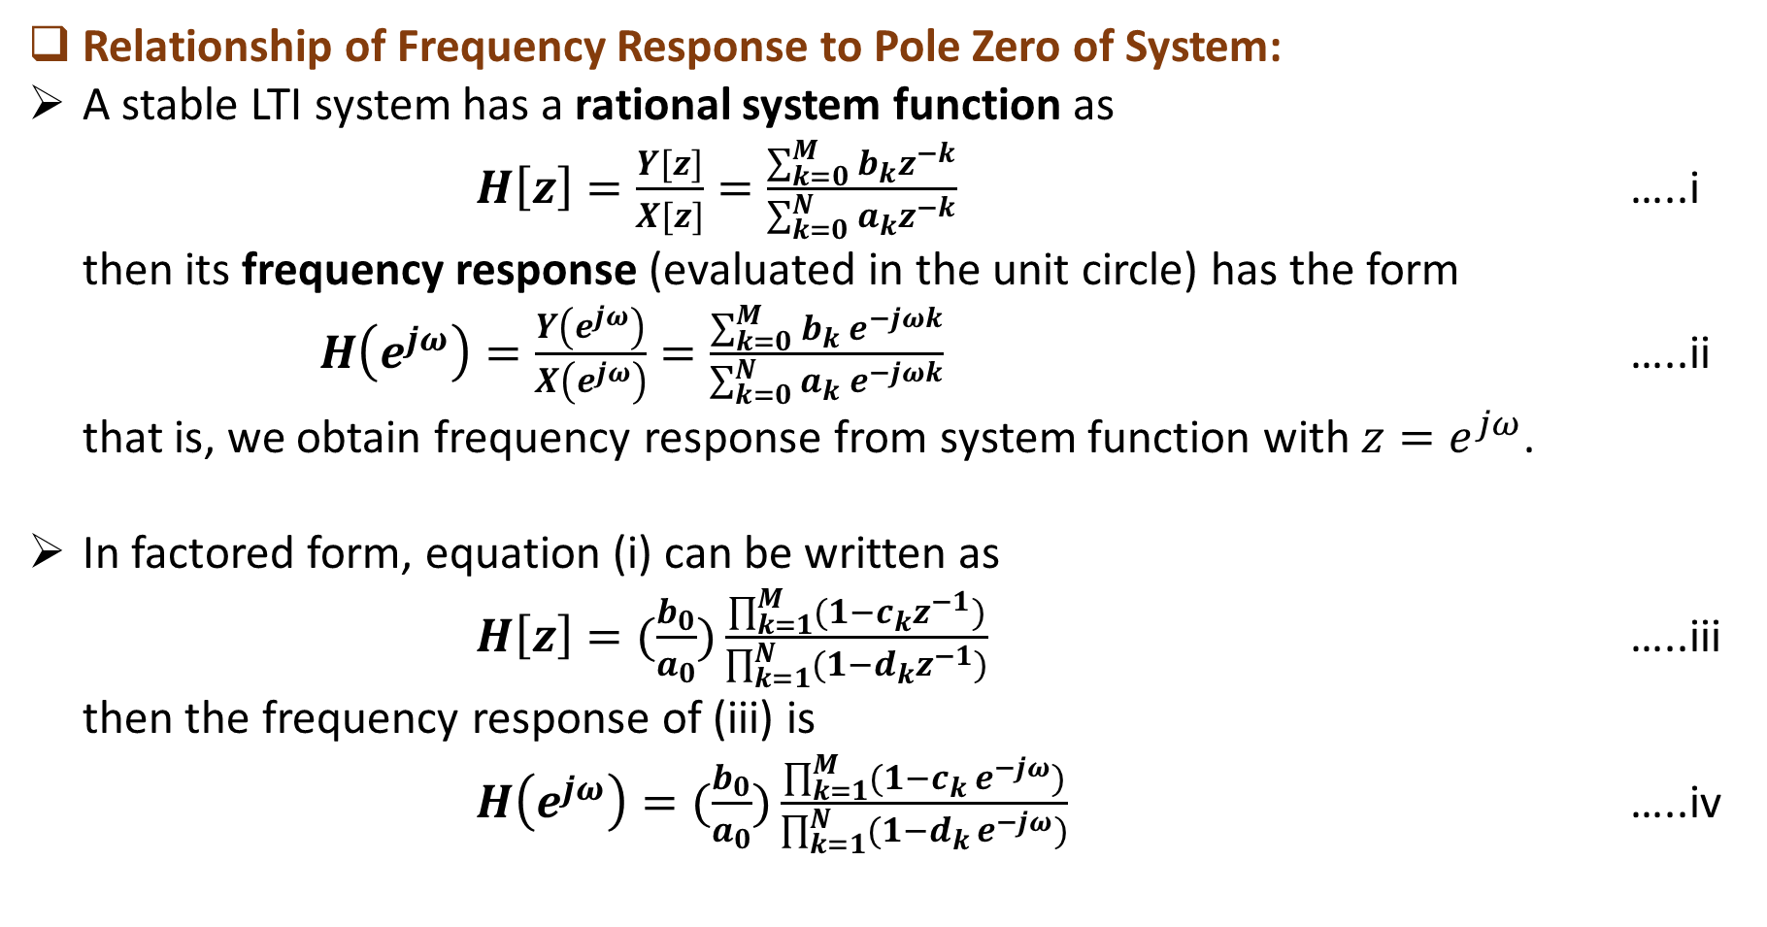
Relationship of Frequency Response to Pole Zero of System:
A stable LTI system has a rational system function as
$H\left[z\right]=\frac{Y[z]}{X[z]}=\frac{\sum_{k=0}^{M}{b_{k}}z^{−k}}{\sum_{k=0}^{N}{a_{k}}z^{−k}}$ …..i
then its frequency response (evaluated in the unit circle) has the form
$H\left(e^{jω}\right)=\frac{Y\left(e^{jω}\right)}{X\left(e^{jω}\right)}=\frac{\sum_{k=0}^{M}{b_{k} }e^{−jωk}}{\sum_{k=0}^{N}{a_{k}}{ e}^{−jωk}}$ …..ii
that is, we obtain frequency response from system function with $z=e^{jω}$.
In factored form, equation (i) can be written as
$H\left[z\right]=(\frac{b_{0}}{a_{0}})\frac{\prod_{k=1}^{M}{(1−c_{k}z^{−1})}}{\prod_{k=1}^{N}{(1−d_{k}z^{−1})}}$ …..iii
then the frequency response of (iii) is
$H\left(e^{jω}\right)=(\frac{b_{0}}{a_{0}})\frac{\prod_{k=1}^{M}{(1−c_{k }e^{−jω})}}{\prod_{k=1}^{N}{(1−d_{k }e^{−jω})}}$ …..iv

Slide 23
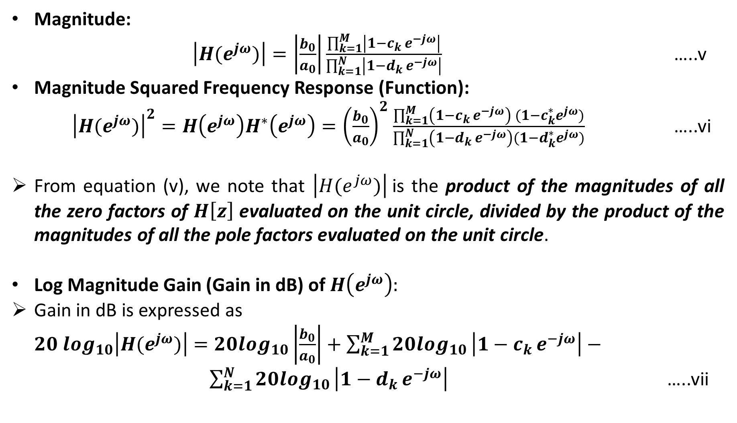
Magnitude:
$\left|H(e^{jω})\right|=\left|\frac{b_{0}}{a_{0}}\right|\frac{\prod_{k=1}^{M}{\left|1−c_{k }e^{−jω}\right|}}{\prod_{k=1}^{N}{\left|1−d_{k }e^{−jω}\right|}}$ …..v
Magnitude Squared Frequency Response (Function):
${\left|H(e^{jω})\right|}^{2}=H\left(e^{jω}\right)H^{∗}\left(e^{jω}\right)={\left(\frac{b_{0}}{a_{0}}\right)}^{2}$ $\frac{\prod_{k=1}^{M}{\left(1−c_{k }e^{−jω}\right)} (1−c_{k}^{∗}e^{jω})}{\prod_{k=1}^{N}{\left(1−d_{k }e^{−jω}\right)(1−d_{k}^{∗}e^{jω})}}$ …..vi
From equation (v), we note that $\left|H(e^{jω})\right|$is the product of the magnitudes of all the zero factors of $H\left[z\right]$ evaluated on the unit circle, divided by the product of the magnitudes of all the pole factors evaluated on the unit circle.
Log Magnitude Gain (Gain in dB) of $H\left(e^{jω}\right):$
Gain in dB is expressed as
$20\log_{10}\left|H(e^{jω})\right|=20\log_{10}\left|\frac{b_{0}}{a_{0}}\right|+\sum_{k=1}^{M}{20\log_{10}}\left|1−c_{k }e^{−jω}\right|− \sum_{k=1}^{N}{20\log_{10}}\left|1−d_{k }e^{−jω}\right|$ …..vii

Slide 24
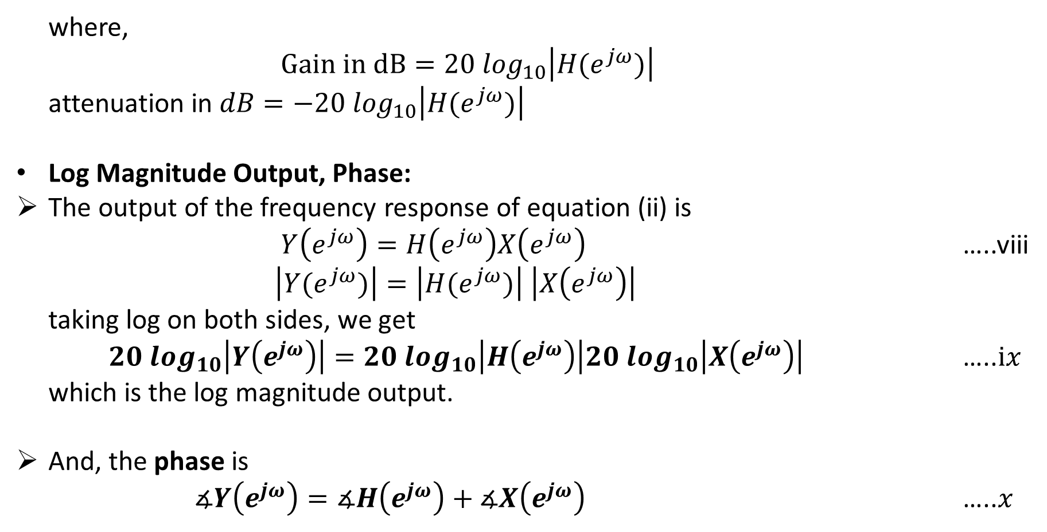
where,
$Gain in dB=20\log_{10}\left|H(e^{jω})\right|$
attenuation in $dB=−20\log_{10}\left|H(e^{jω})\right|$
Log Magnitude Output, Phase:
The output of the frequency response of equation (ii) is
$Y\left(e^{jω}\right)=H\left(e^{jω}\right)X\left(e^{jω}\right)$ …..viii
$\left|Y(e^{jω})\right|=\left|H(e^{jω})\right| \left|X\left(e^{jω}\right)\right|$
taking log on both sides, we get
$20\log_{10}\left|Y\left(e^{jω}\right)\right|=20\log_{10}\left|H\left(e^{jω}\right)\right|20\log_{10}\left|X\left(e^{jω}\right)\right|$ …..$ix$
which is the log magnitude output.
And, the phase is
$∡Y\left(e^{jω}\right)=∡H\left(e^{jω}\right)+∡X\left(e^{jω}\right)$ …..$x$

Slide 25

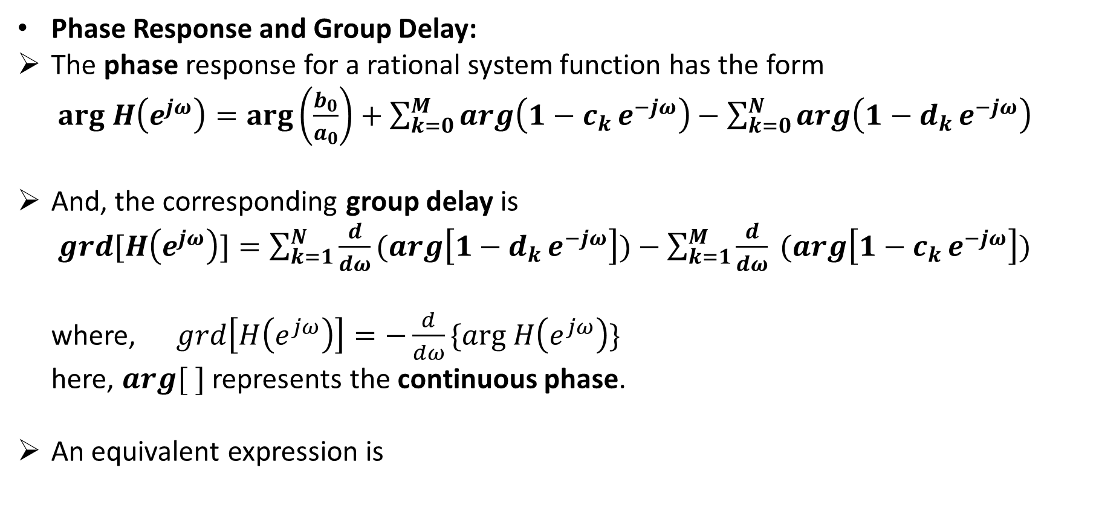
Phase Response and Group Delay:
The phase response for a rational system function has the form
$arg H\left(e^{jω}\right)=\arg\left(\frac{b_{0}}{a_{0}}\right)+\sum_{k=0}^{M}{arg\left(1−c_{k }e^{−jω}\right)}−\sum_{k=0}^{N}{arg\left(1−d_{k }e^{−jω}\right)}$
And, the corresponding group delay is
$grd[H\left(e^{jω}\right)]=\sum_{k=1}^{N}{\frac{d}{dω}(arg\left[1−d_{k }e^{−jω}\right])−\sum_{k=1}^{M}{\frac{d}{dω} (arg\left[1−c_{k }e^{−jω}\right])}}$
where, $grd\left[H\left(e^{jω}\right)\right]=−\frac{d}{dω}\{arg H\left(e^{jω}\right)\}$
here, $arg[ ]$ represents the continuous phase.
An equivalent expression is

Slide 26
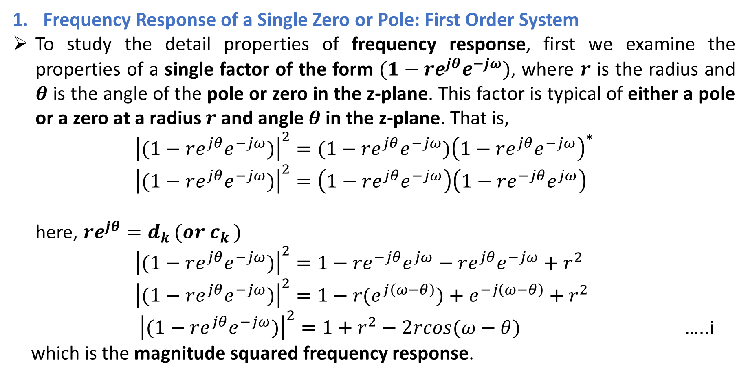
Frequency Response of a Single Zero or Pole: First Order System
To study the detail properties of frequency response, first we examine the properties of a single factor of the form $(1−re^{jθ}e^{−jω})$, where $r$ is the radius and $θ$ is the angle of the pole or zero in the z-plane. This factor is typical of either a pole or a zero at a radius $r$ and angle $θ$ in the z-plane. That is,
${\left|(1−re^{jθ}e^{−jω})\right|}^{2}=(1−re^{jθ}e^{−jω}){\left(1−re^{jθ}e^{−jω}\right)}^{∗}$
${\left|(1−re^{jθ}e^{−jω})\right|}^{2}=\left(1−re^{jθ}e^{−jω}\right)\left(1−re^{−jθ}e^{jω}\right)$
here, $re^{jθ}=d_{k }(or c_{k })$
${\left|(1−re^{jθ}e^{−jω})\right|}^{2}=1−re^{−jθ}e^{jω}−re^{jθ}e^{−jω}+r^{2}$
${\left|(1−re^{jθ}e^{−jω})\right|}^{2}=1−r(e^{j\left(ω−θ\right)})+e^{−j\left(ω−θ\right)}+r^{2}$
${\left|(1−re^{jθ}e^{−jω})\right|}^{2}=1+r^{2}−2rcos(ω−θ)$ …..i
which is the magnitude squared frequency response.

Slide 27
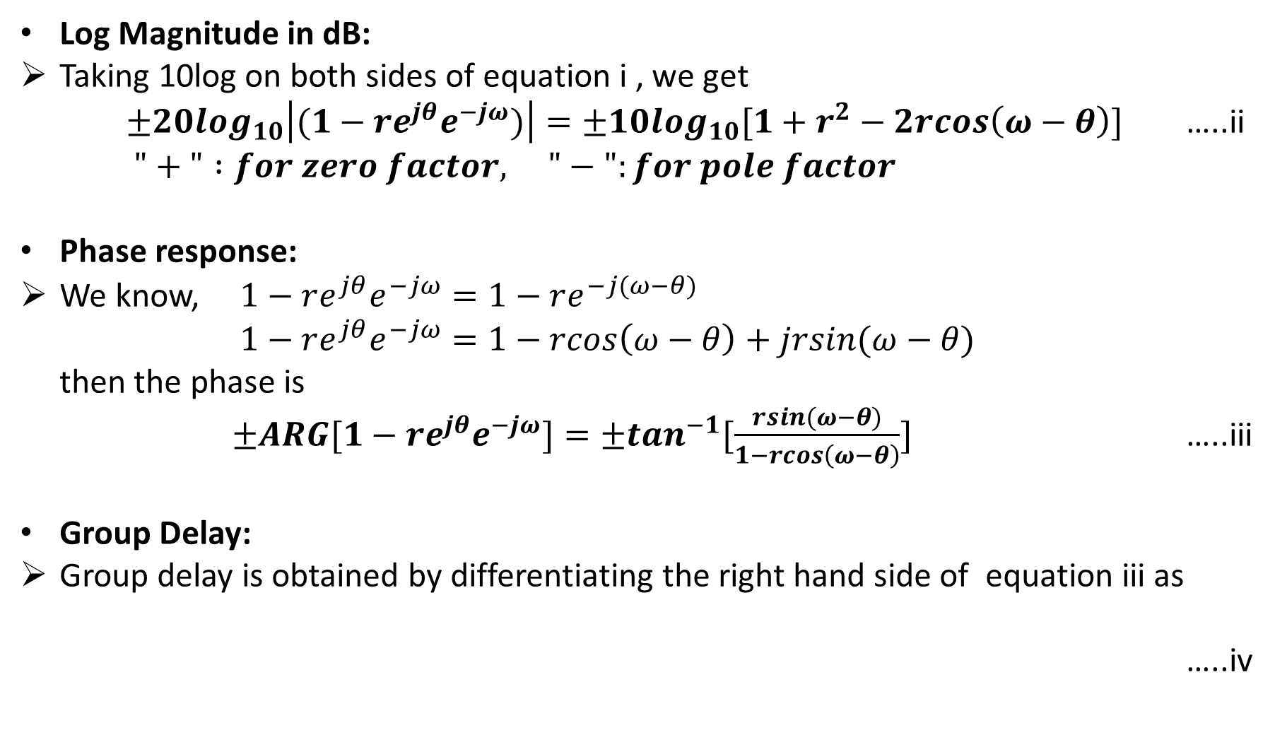
Log Magnitude in dB:
Taking 10log on both sides of equation i , we get
$±20\log_{10}\left|(1−re^{jθ}e^{−jω})\right|=±10\log_{10}[1+r^{2}−2rcos\left(ω−θ\right)]$ …..ii
$"+" :for zero factor, "−":for pole factor$
Phase response:
We know, $1−re^{jθ}e^{−jω}=1−re^{−j(ω−θ)}$
$1−re^{jθ}e^{−jω}=1−rcos\left(ω−θ\right)+jrsin(ω−θ)$
then the phase is
$±ARG[1−re^{jθ}e^{−jω}]=±\tan^{−1}[\frac{rsin(ω−θ)}{1−rcos\left(ω−θ\right)}]$ …..iii
Group Delay:
Group delay is obtained by differentiating the right hand side of equation iii as
…..iv

Slide 28
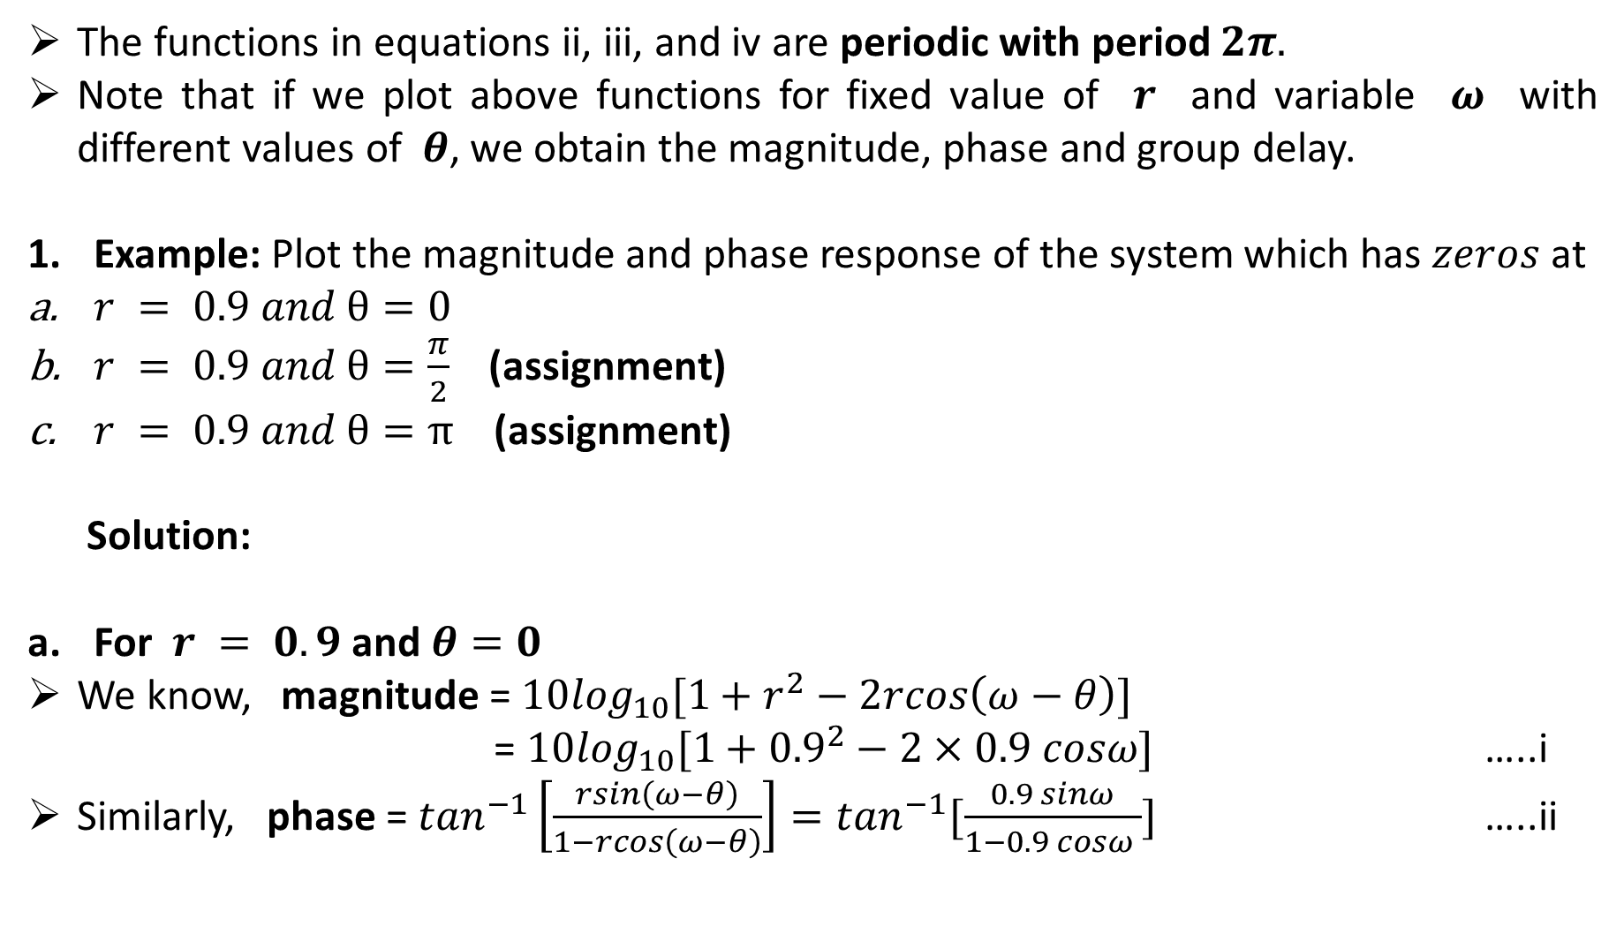
The functions in equations ii, iii, and iv are periodic with period $2π.$
Note that if we plot above functions for fixed value of $r$ and variable $ω$ with different values of $θ$, we obtain the magnitude, phase and group delay.
Example: Plot the magnitude and phase response of the system which has $zeros$ at
$r = 0.9 and θ=0$
$r = 0.9 and θ=\frac{π}{2}$(assignment)
$r = 0.9 and θ=π$ (assignment)
Solution:
For $r = 0.9$ and $θ=0$
We know, magnitude = $10\log_{10}[1+r^{2}−2rcos\left(ω−θ\right)]$
= $10\log_{10}[1+{0.9}^{2}−2×0.9 cosω]$ …..i
Similarly, phase = $\tan^{−1}\left[\frac{rsin\left(ω−θ\right)}{1−rcos\left(ω−θ\right)}\right]=\tan^{−1}[\frac{0.9 sinω}{1−0.9 cosω }]$ …..ii

Slide 29
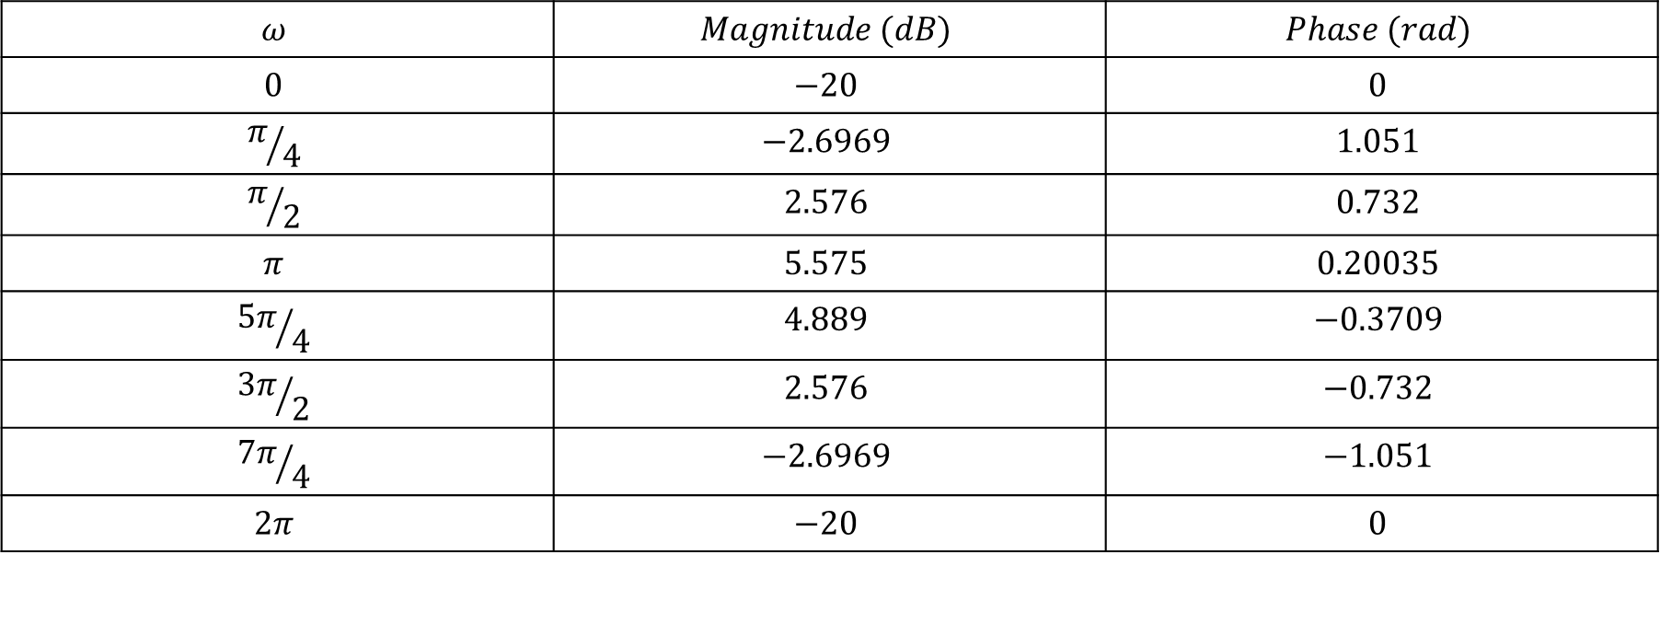
$$ω$$ | $$Magnitude (dB)$$ | $$Phase (rad)$$
$$0$$ | $$−20$$ | $$0$$
$$π/4$$ | $$−2.6969$$ | $$1.051$$
$$π/2$$ | $$2.576$$ | $$0.732$$
$$π$$ | $$5.575$$ | $$0.20035$$
$${5π}/4$$ | $$4.889$$ | $$−0.3709$$
$${3π}/2$$ | $$2.576$$ | $$−0.732$$
$${7π}/4$$ | $$−2.6969$$ | $$−1.051$$
$$2π$$ | $$−20$$ | $$0$$

Slide 30
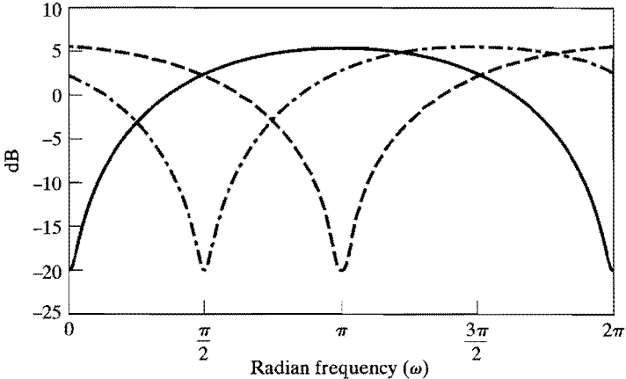
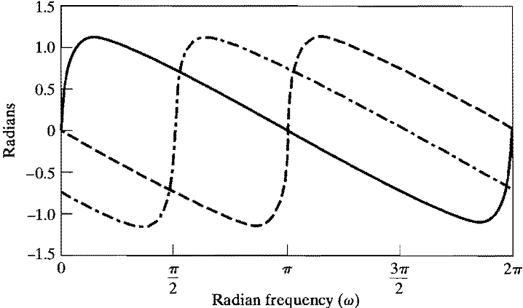



Magnitude response
$$θ=0$$
$$θ=\frac{π}{2}$$
$$θ=π$$
Phase response

Slide 31
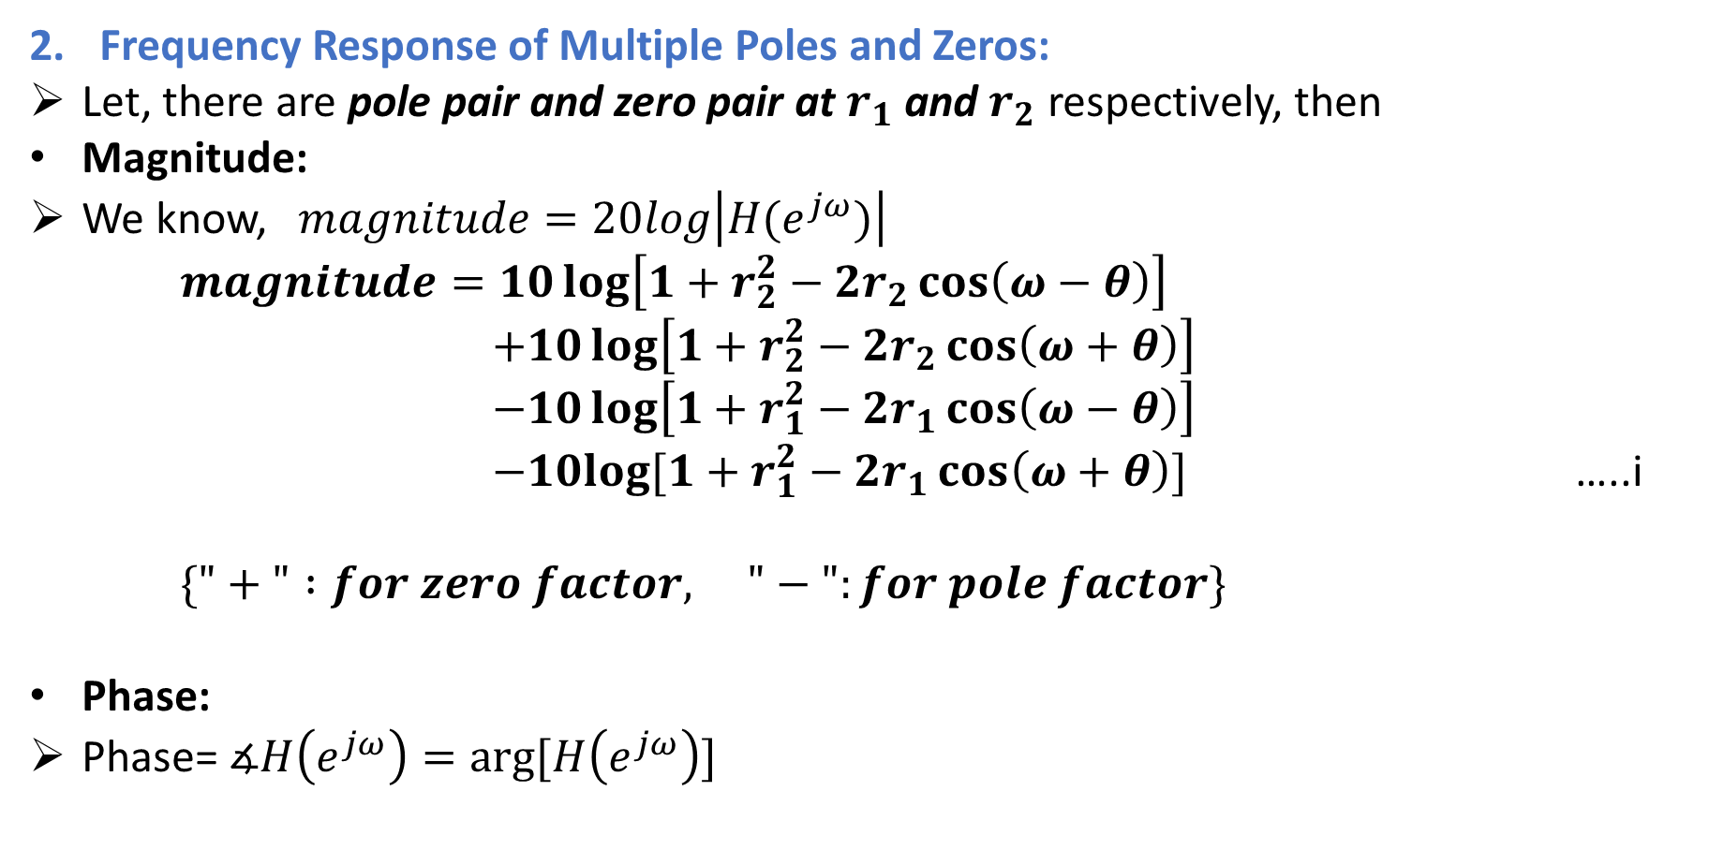
Frequency Response of Multiple Poles and Zeros:
Let, there are pole pair and zero pair at $r_{1}$ and $r_{2}$ respectively, then
Magnitude:
We know, $magnitude=20log\left|H(e^{jω})\right|$
$magnitude=10\log\left[1+r_{2}^{2}−2r_{2}\cos\left(ω−θ\right)\right]$
$+10\log\left[1+r_{2}^{2}−2r_{2}\cos\left(ω+θ\right)\right]$
$−10\log\left[1+r_{1}^{2}−2r_{1}\cos\left(ω−θ\right)\right]$
$−10log⁡[1+r_{1}^{2}−2r_{1}\cos\left(ω+θ\right)]$ …..i
$\{"+" :for zero factor, "−":for pole factor\}$
Phase:
Phase= $∡H\left(e^{jω}\right)=arg⁡[H\left(e^{jω}\right)]$

Slide 32
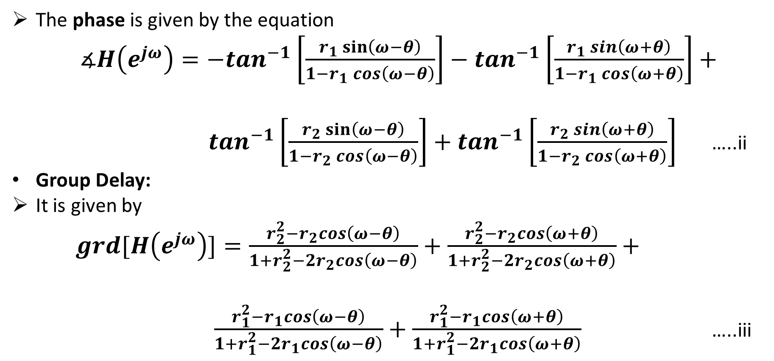
The phase is given by the equation
$∡H\left(e^{jω}\right)=−\tan^{−1}\left[\frac{r_{1}\sin\left(ω−θ\right)}{1−r_{1}\cos\left(ω−θ\right)}\right]−\tan^{−1}\left[\frac{r_{1}\sin\left(ω+θ\right)}{1−r_{1}\cos\left(ω+θ\right)}\right]+$
$\tan^{−1}\left[\frac{r_{2}\sin\left(ω−θ\right)}{1−r_{2}\cos\left(ω−θ\right)}\right]+\tan^{−1}\left[\frac{r_{2}\sin\left(ω+θ\right)}{1−r_{2}\cos\left(ω+θ\right)}\right]$ …..ii
Group Delay:
It is given by
$grd[H\left(e^{jω}\right)]=\frac{r_{2}^{2}−r_{2}cos\left(ω−θ\right)}{1+r_{2}^{2}−2r_{2}cos\left(ω−θ\right)}+\frac{r_{2}^{2}−r_{2}cos\left(ω+θ\right)}{1+r_{2}^{2}−2r_{2}cos\left(ω+θ\right)}+$
$\frac{r_{1}^{2}−r_{1}cos\left(ω−θ\right)}{1+r_{1}^{2}−2r_{1}cos\left(ω−θ\right)}+\frac{r_{1}^{2}−r_{1}cos\left(ω+θ\right)}{1+r_{1}^{2}−2r_{1}cos\left(ω+θ\right)}$ …..iii

Slide 33
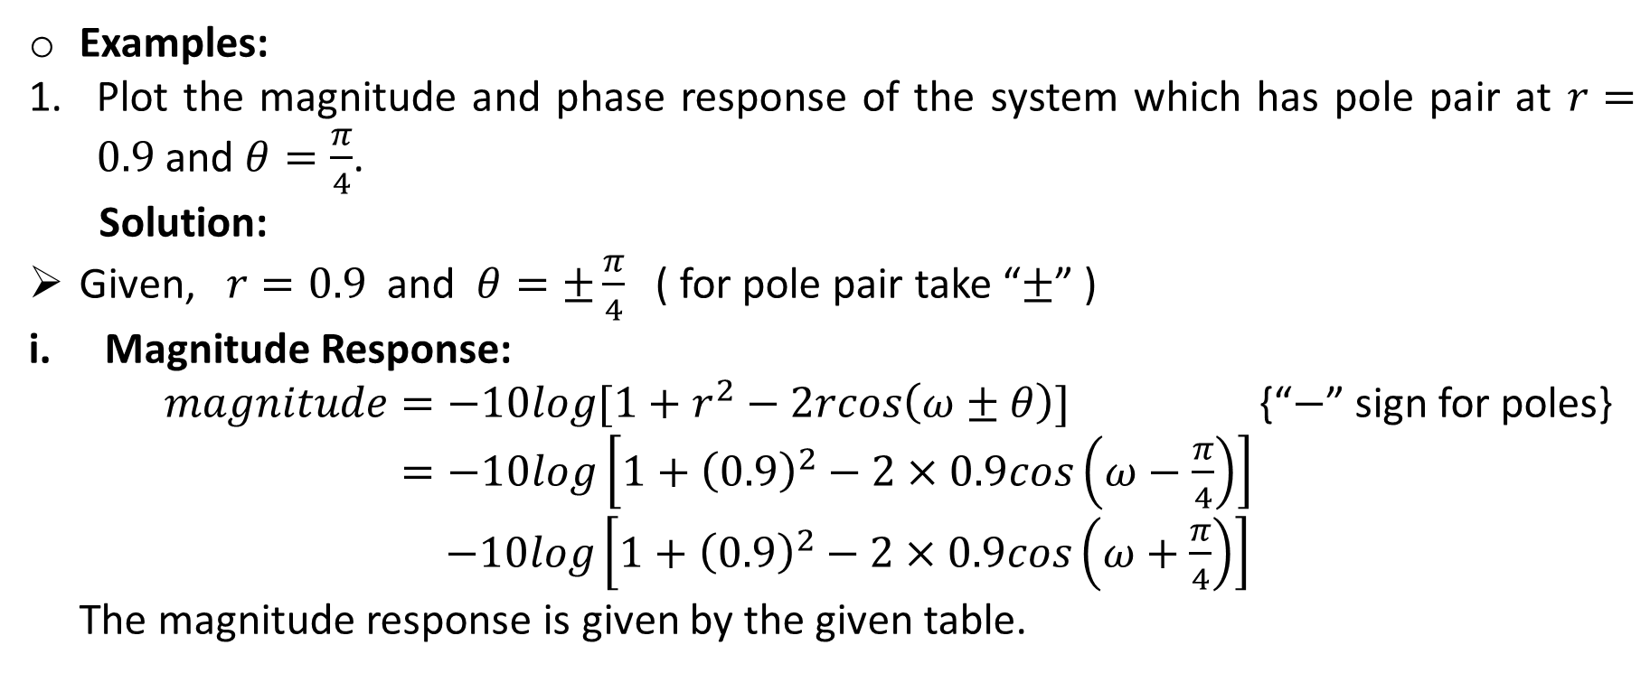
Examples:
Plot the magnitude and phase response of the system which has pole pair at $r=0.9$ and $θ=\frac{π}{4}$.
Solution:
Given, $r=0.9$ and $θ=±\frac{π}{4}$ ( for pole pair take “$±$” )
Magnitude Response:
$magnitude=−10log[1+r^{2}−2rcos\left(ω±θ\right)]$ {“$−$” sign for poles}
$=−10log\left[1+{\left(0.9\right)}^{2}−2×0.9cos\left(ω−\frac{π}{4}\right)\right]$
$−10log\left[1+{\left(0.9\right)}^{2}−2×0.9cos\left(ω+\frac{π}{4}\right)\right]$
The magnitude response is given by the given table.

Slide 34
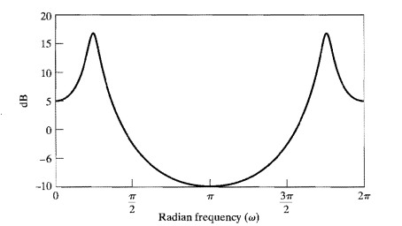
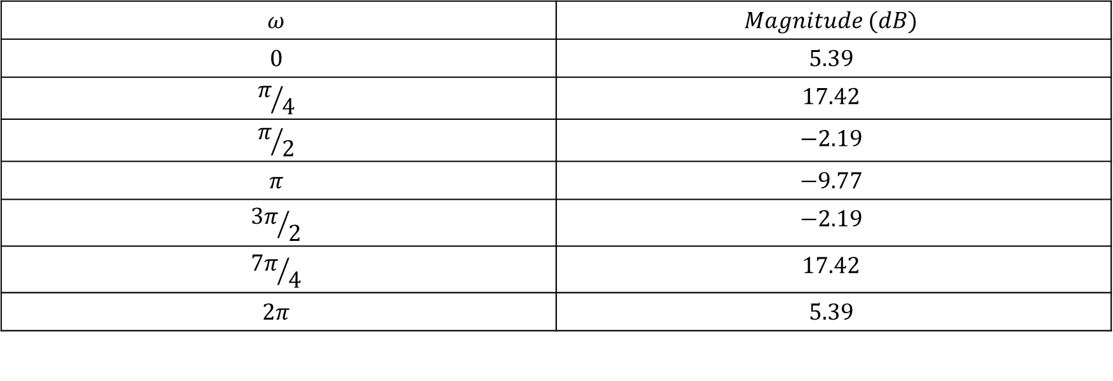
$$ω$$ | $$Magnitude (dB)$$
$$0$$ | $$5.39$$
$$π/4$$ | $$17.42$$
$$π/2$$ | $$−2.19$$
$$π$$ | $$−9.77$$
$${3π}/2$$ | $$−2.19$$
$${7π}/4$$ | $$17.42$$
$$2π$$ | $$5.39$$
Magnitude response

Slide 35
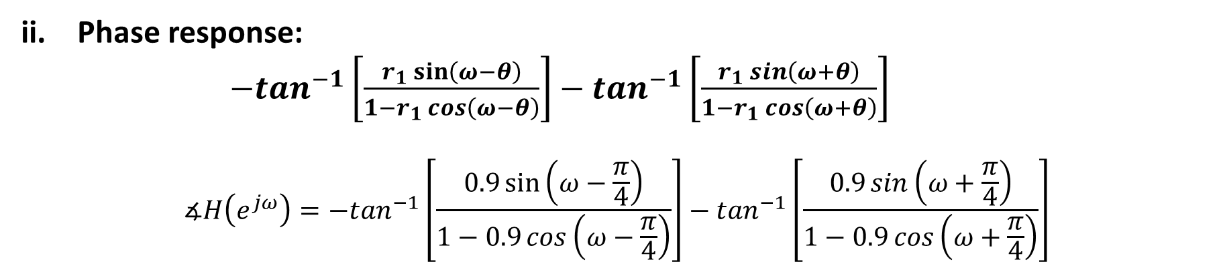
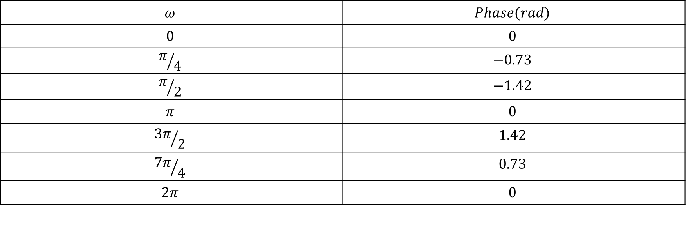
Phase response:
$−\tan^{−1}\left[\frac{r_{1}\sin\left(ω−θ\right)}{1−r_{1}\cos\left(ω−θ\right)}\right]−\tan^{−1}\left[\frac{r_{1}\sin\left(ω+θ\right)}{1−r_{1}\cos\left(ω+θ\right)}\right]$
$$∡H\left(e^{jω}\right)=−\tan^{−1}\left[\frac{0.9\sin\left(ω−\frac{π}{4}\right)}{1−0.9\cos\left(ω−\frac{π}{4}\right)}\right]−\tan^{−1}\left[\frac{0.9\sin\left(ω+\frac{π}{4}\right)}{1−0.9\cos\left(ω+\frac{π}{4}\right)}\right]$$
$$ω$$ | $$Phase(rad)$$
$$0$$ | $$0$$
$$π/4$$ | $$−0.73$$
$$π/2$$ | $$−1.42$$
$$π$$ | $$0$$
$${3π}/2$$ | $$1.42$$
$${7π}/4$$ | $$0.73$$
$$2π$$ | $$0$$

Slide 36
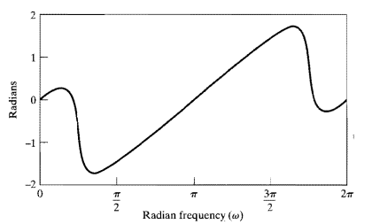
Phase response

Slide 37
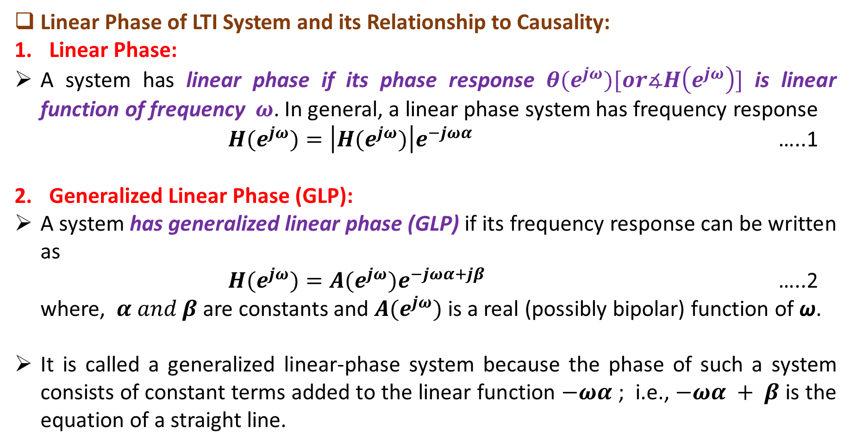
Linear Phase of LTI System and its Relationship to Causality:
Linear Phase:
A system has linear phase if its phase response ${θ(e}^{jω})[or∡H\left(e^{jω}\right)]$ is linear function of frequency $ω$. In general, a linear phase system has frequency response
${H(e}^{jω})=\left|H{(e}^{jω})\right|e^{−jωα}$ …..1
Generalized Linear Phase (GLP):
A system has generalized linear phase (GLP) if its frequency response can be written as
${H(e}^{jω})=A{(e}^{jω})e^{−jωα+jβ}$ …..2
where, $α and β$are constants and $A{(e}^{jω})$ is a real (possibly bipolar) function of ω.
It is called a generalized linear-phase system because the phase of such a system consists of constant terms added to the linear function $−ωα$ ; i.e., $−ωα + β$ is the equation of a straight line.

Slide 38
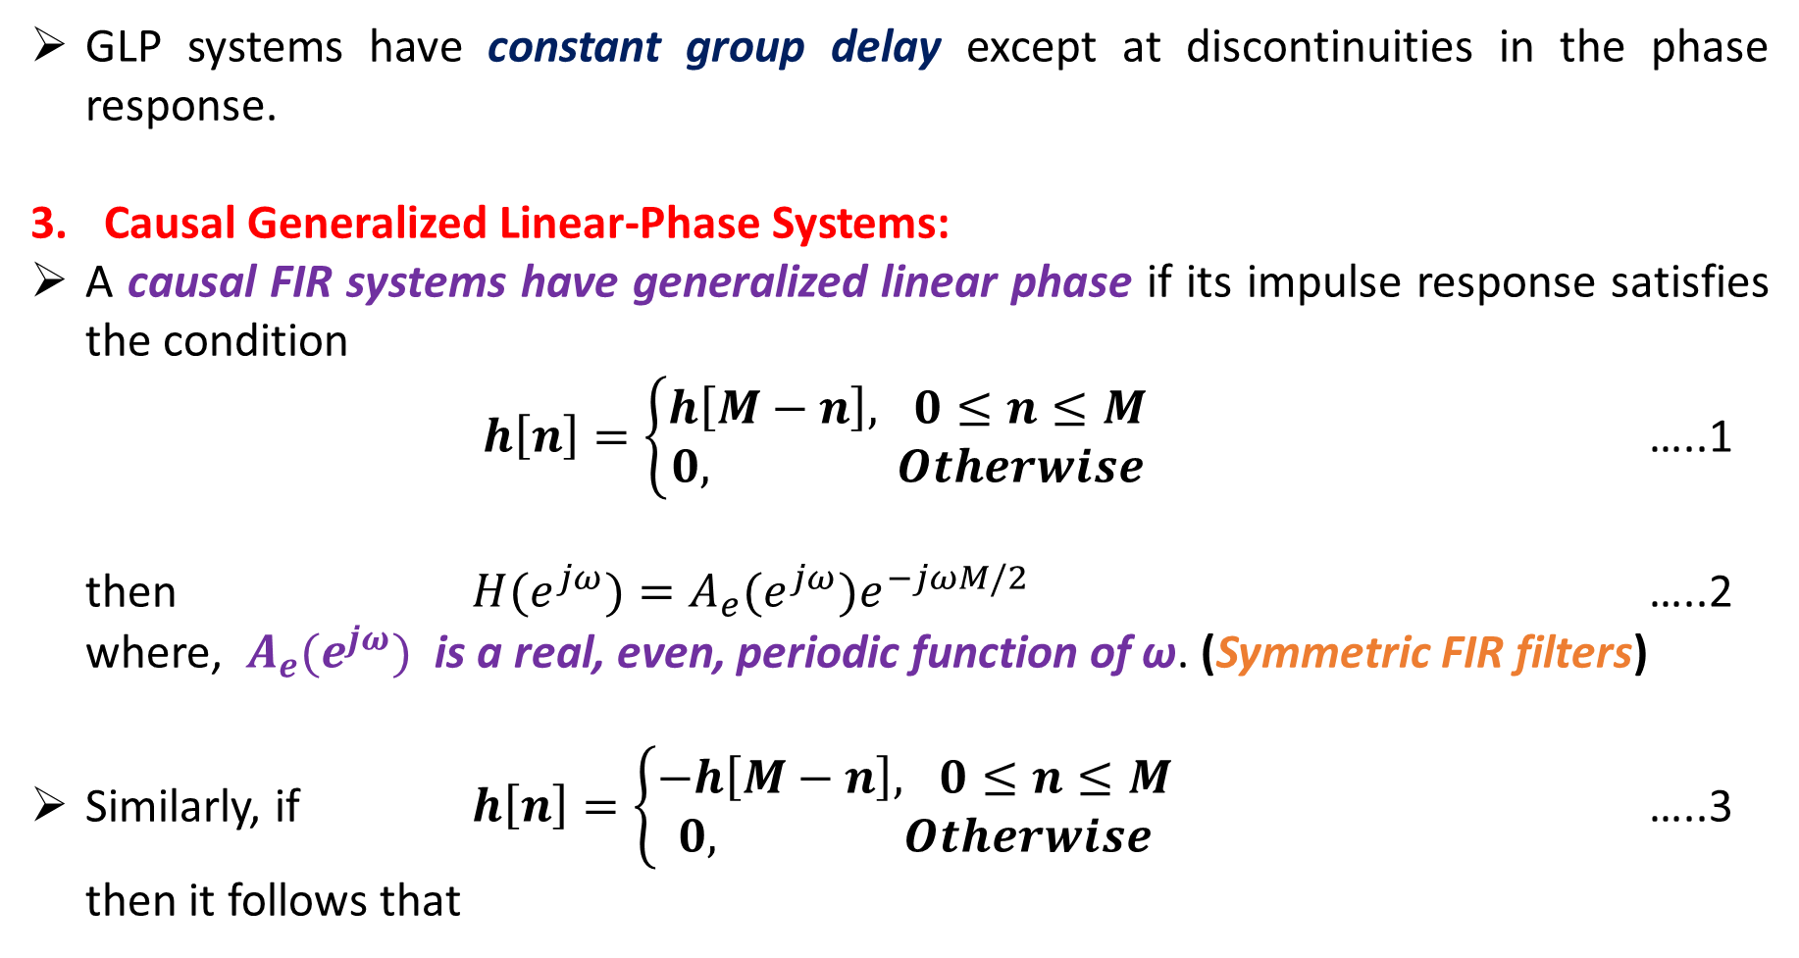
GLP systems have constant group delay except at discontinuities in the phase response.
Causal Generalized Linear-Phase Systems:
A causal FIR systems have generalized linear phase if its impulse response satisfies the condition
$h\left[n\right]=\left\{\begin{aligned}h\left[M−n\right], 0≤n≤M \\ 0, Otherwise\end{aligned}\right.$ …..1
then ${H(e}^{jω})=A_{e}(e^{jω})e^{−jωM/2}$ …..2
where, $A_{e}(e^{jω})$ is a real, even, periodic function of ω. (Symmetric FIR filters)
Similarly, if $h\left[n\right]=\left\{\begin{aligned}−h\left[M−n\right], 0≤n≤M \\ 0, Otherwise\end{aligned}\right.$ …..3
then it follows that

Slide 39
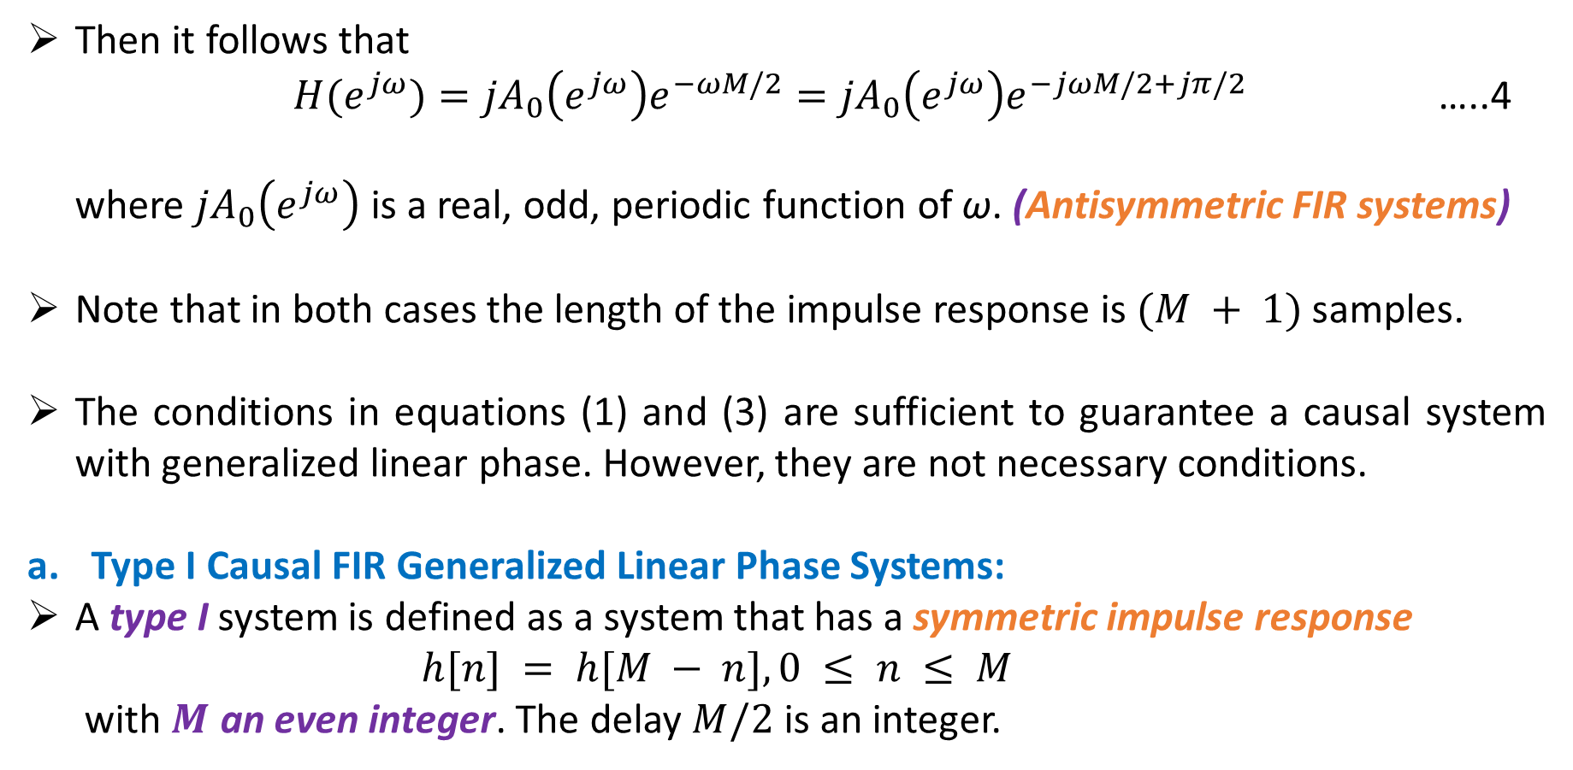
Then it follows that
${H(e}^{jω})={jA}_{0}\left(e^{jω}\right)e^{−ωM/2}={jA}_{0}\left(e^{jω}\right)e^{−jωM/2+jπ/2}$ …..4
where ${jA}_{0}\left(e^{jω}\right)$ is a real, odd, periodic function of ω. (Antisymmetric FIR systems)
Note that in both cases the length of the impulse response is $(M + 1)$ samples.
The conditions in equations (1) and (3) are sufficient to guarantee a causal system with generalized linear phase. However, they are not necessary conditions.
Type I Causal FIR Generalized Linear Phase Systems:
A type I system is defined as a system that has a symmetric impulse response
$h[n] = h[M − n], 0 ≤ n ≤ M$
with $M$ an even integer. The delay $M/2$ is an integer.

Slide 40
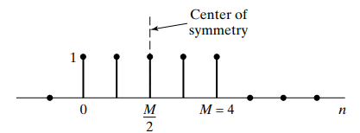
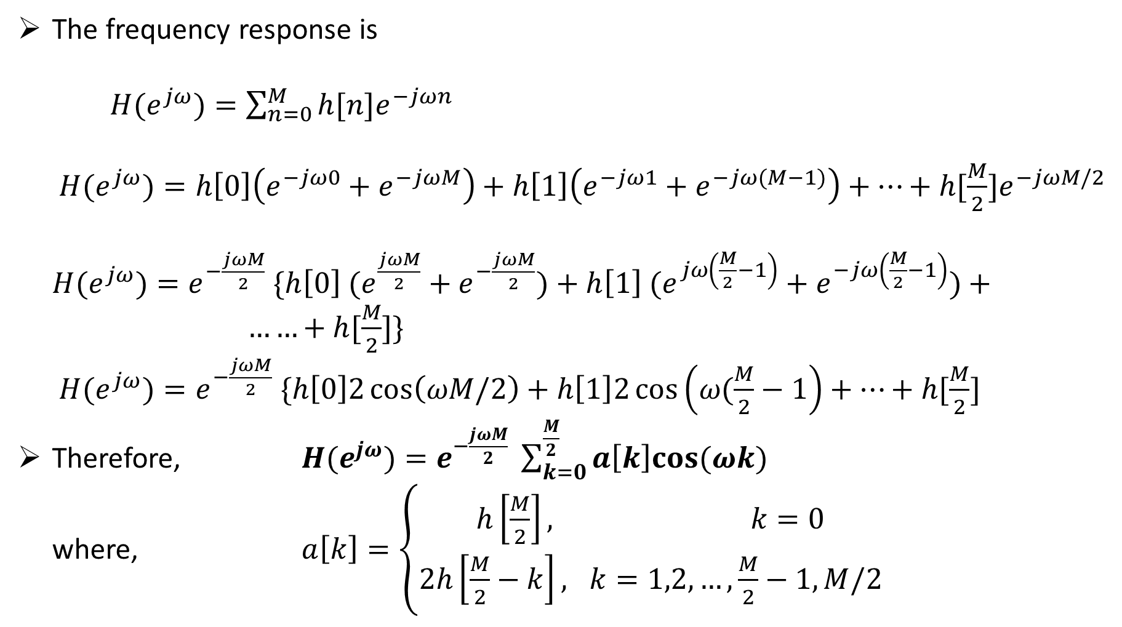
The frequency response is
${H(e}^{jω})=\sum_{n=0}^{M}{h[n]e^{−jωn}}$
${H(e}^{jω})=h\left[0\right]\left(e^{−jω0}+e^{−jωM}\right)+h\left[1\right]\left(e^{−jω1}+e^{−jω(M−1)}\right)+…+h[\frac{M}{2}]e^{−jωM/2}$
${H(e}^{jω})=e^{−\frac{jωM}{2}} \{h\left[0\right] (e^{\frac{jωM}{2}}+e^{−\frac{jωM}{2}})+h\left[1\right] (e^{jω\left(\frac{M}{2}−1\right)}+e^{−jω\left(\frac{M}{2}−1\right)})+ ……+h[\frac{M}{2}]\}$
${H(e}^{jω})=e^{−\frac{jωM}{2}} \{h\left[0\right]2\cos\left(ωM/2\right)+h\left[1\right]2\cos\left(ω(\frac{M}{2}−1\right)+…+h[\frac{M}{2}]$
Therefore, ${H(e}^{jω})=e^{−\frac{jωM}{2}} \sum_{k=0}^{\frac{M}{2}}{a\left[k\right]cos⁡(ωk)}$
where, $a\left[k\right]=\left\{\begin{aligned}h\left[\frac{M}{2}\right], k=0 \\ 2h\left[\frac{M}{2}−k\right], k=1,2,…,\frac{M}{2}−1,M/2\end{aligned}\right.$

Slide 41


Type II Causal FIR Generalized Linear Phase Systems:
A type I system is defined as a system that has a symmetric impulse response
$h[n] = h[M − n], 0 ≤ n ≤ M$
with $M$ an odd integer.
The frequency response is
${H(e}^{jω})=\sum_{n=0}^{M}{h[n]e^{−jωn}}$
${H(e}^{jω})=\{h\left[0\right]e^{−jω0}+h\left[1\right]e^{−jω1}+…+h[(M−1)/2{]e}^{−jω(M−1)/2}$}
$+\{h[(M+1)/2{] e}^{−jω(M−1)/2}$ $+…+h[M]e^{−jωM}$

Slide 42

Since, $h[n] = h[M − n], 0 ≤ n ≤ M$
then $h[0] = h[M]$
$h[1] = h[M−1]$
. .
. .
$h[(M−1)/2$ $=$ $h[(M+1)/2$
Now, ${H(e}^{jω})=e^{−jωM/2} \{h[0]( e^{jωM/2}+e^{−jωM/2} )$ $+…$
$…+h[(M−1)/2]( e^{jω/2}+e^{−jω/2} )$
${H(e}^{jω})=e^{−jωM/2} \{h\left[0\right]2\cos\left(\frac{ωM}{2}\right)+…+h[(M−1)/2]2\cos\left(\frac{ω}{2}\right)\}$
Therefore, ${H(e}^{jω})=e^{−jωM/2}\sum_{k=0}^{(M−1)/2}{b\left[k\right]cos⁡\{ω\left(k+\frac{1}{2}\right)\}}$
where $b\left[k\right]=2h[\frac{M−1}{2}−k]$, $k=1,2,…,(M−1)/2$

Slide 43


Type III Causal FIR Generalized Linear Phase Systems:
A type I system is defined as a system that has a antisymmetric impulse response
$h\left[n\right]=−h[M − n], 0 ≤ n ≤ M$
with $M$ an even integer.
Also, $h\left[\frac{M}{2}\right]=0$
The frequency response is
${H(e}^{jω})=\sum_{n=0}^{M}{h[n]e^{−jωn}}$
${H(e}^{jω})=h\left[0\right]\left(e^{−jω0}−e^{−jωM}\right)+h\left[1\right]\left(e^{−jω1}−e^{−jω(M−1)}\right)+…+h[\frac{M}{2}]e^{−jωM/2}$
${H(e}^{jω})=e^{−\frac{jωM}{2}} \{h\left[0\right] (e^{\frac{jωM}{2}}−e^{−\frac{jωM}{2}})+h\left[1\right] (e^{jω\left(\frac{M}{2}−1\right)}−e^{−jω\left(\frac{M}{2}−1\right)})+…\}$
${H(e}^{jω})=e^{−\frac{jωM}{2}} \{h\left[0\right]2j\sin\left(ωM/2\right)+h\left[1\right]2j\sin\left(ω(\frac{M}{2}−1\right)+…+h[\frac{M}{2}]$
Therefore, ${H(e}^{jω})=je^{−\frac{jωM}{2}} \sum_{k=0}^{\frac{M}{2}−1}{c\left[k\right]sin⁡[ω\left(k+1\right)]}$

Slide 44


Therefore, ${H(e}^{jω})=je^{−\frac{jωM}{2}} \sum_{k=0}^{\frac{M}{2}−1}{c\left[k\right]sin⁡[ω\left(k+1\right)]}$
where,
$c\left[k\right]=2h\left[\frac{M}{2}−k−1\right]$
Type IV Causal FIR Generalized Linear Phase Systems:
A type I system is defined as a system that has a antisymmetric impulse response
$h\left[n\right]=−h[M − n], 0 ≤ n ≤ M$
with $M$ an odd integer.

Slide 45

The frequency response is
${H(e}^{jω})=\sum_{n=0}^{M}{h[n]e^{−jωn}}$
${H(e}^{jω})=\{h\left[0\right]e^{−jω0}+h\left[1\right]e^{−jω1}+…+h[(M−1)/2{]e}^{−jω(M−1)/2}$}
$+\{h[(M+1)/2{] e}^{−jω(M−1)/2}$ $+…+h[M]e^{−jωM}$
Since, $h\left[n\right]=− h[M − n], 0 ≤ n ≤ M$
then $h\left[0\right]=− h[M]$
$h\left[1\right]=− h[M−1]$
. .
. .
$h[(M−1)/2$ $=$ $−h[(M+1)/2$
Now, ${H(e}^{jω})=e^{−jωM/2} \{h[0]( e^{jωM/2}−e^{−jωM/2} )$ $+…$
$…+h[(M−1)/2]( e^{jω/2}−e^{−jω/2})$
${H(e}^{jω})=e^{−jωM/2} \{h\left[0\right]2\operatorname{jsin}\left(\frac{ωM}{2}\right)+…+h[(M−1)/2]2\operatorname{jsin}\left(\frac{ω}{2}\right)\}$

Slide 46

Therefore, ${H(e}^{jω})=je^{−jωM/2}\sum_{k=0}^{(M−1)/2}{d\left[k\right]sin⁡\{ω\left(k+\frac{1}{2}\right)\}}$
$d\left[k\right]=2h[\frac{M−1}{2}−k]$, $k=1,2,…,(M−1)/2$

